Slide 1
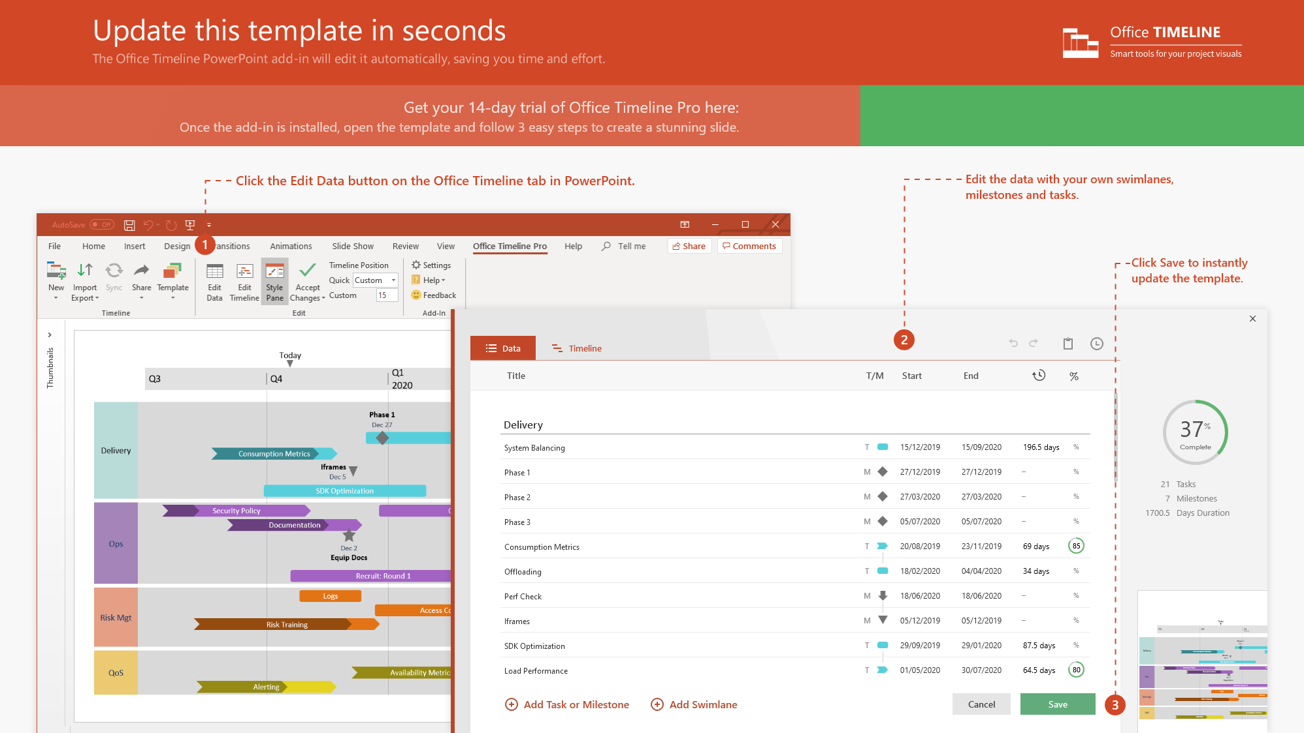
https://www.officetimeline.com/14-days-trial

Slide 2



Vaccines and the diseases they prevent
HepB - Hepatitis B
RV – Rotavirus
DTaP – Diphtheria, Pertussis (whooping cough), Tetanus
MMR – Measles, Mumps, Rubella
HiB – Haemophilus influenzae type B
PCV13 – Pneumococcus (bacteremia, meningitis)
IPV – Polio
Influenza – Flu
HepA – Hepatitis A
0 – 25 months old
Birth
HepB
(1 Month)
IPV
(6 Months)
HiB
(12 Months)
MMR
(15 Months)
DTaP
(18 Months)
Influenza
(23 Months)
November 2021
April 2022
October 2022
January 2023
April 2023
September 2023
2021
2022
2023
Sep
Dec
Mar
Jun
Sep
Dec
Mar
Jun
Sep
Dec
09/26
12/04
02/11
04/21
06/29
09/06
11/14
01/22
04/01
06/09
08/17
10/25
December 2021
October 2022
January 2023
May 2023
November 2023
RV
(2 Months)
Varicella
(12 Months)
PCV13
(15 Months)
HepA 1st Dose (19 Months)
HepA 2nd Dose (25 Months)

Slide 3


7 – 20 years old
Vaccines and the diseases they prevent
Flu – Influenza
HPV - Human Papillomavirus
Tdap - Tetanus, Diphtheria, Pertussis
MenACWY - Meningococcal Disease
7th Birthday
HPV 1st Dose
HPV 2nd Dose
Flu
(7 years)
Flu
(9 Years)
Flu
(11 years)
Flu
(13 Years)
Flu
(15 Years)
Flu
(17 years)
Flu
(19 years)
2021
2023
2025
2027
2029
2031
2033
Flu
(8 Years)
Flu
(10 Years)
Flu
(12 Years)
Flu
(14 Years)
Flu
(16 years)
Flu
(18 years)
Flu
(20 years)
Tdap Single Dose
MenACWY

