Slide 1
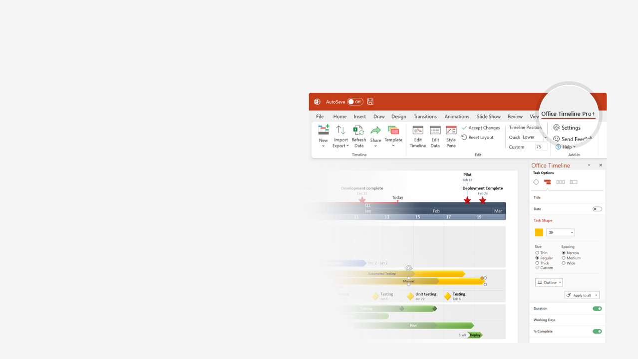

How to update this template in seconds
The Office Timeline add-in for PowerPoint will help you edit it with just a few clicks.
Get your free 14-day trial of Office Timeline here:
https://www.officetimeline.com/14-days-trial
Re-open this template, and create your impressive
PowerPoint visual in 3 easy steps:
1
Click the Edit Data button on the Office Timeline tab.
2
Use the Data and Timeline views to edit swimlanes, milestones and tasks.
3
Click Save to instantly update the template.

Slide 2


1939
2026
Today
Tina Turner timeline
(1939-2023)
Files for divorce from Ike
Receives Kennedy Center honors
1976
Earns Grammy Award for "Proud Mary"
2005
1969
Passes away in Switzerland, aged 83
Played by Angela Basset in biographical film "What's love got to do with it?"
May 24, 2023
Ike & Tina open for
Rolling Stones on UK tour
1993
1966
"Tina" musical debuts in London
Born Anna-Mae Bullock in Nutbrush, Tennessee
2018
Takes the stage name Tina Turner, start of Ike & Tina Turner Revue
Stars in "Mad Max Beyond Thunderdome"
November 26, 1939
Retires officially from performing
1960
1985
2009
1939
1947
1955
1963
1971
1979
1987
1995
2003
2011
2019
1956
1975
2021
Moves to St. Louis, meets Ike Turner
Stars in her first film, "Tommy" by The Who
Is inducted in Rock and Roll Hall of Fame as solo act
2008
1984
Embarks on 50th Anniversary Tour
1962
Marries Ike Turner in Tijuana, Mexico
Releases comeback album "Private Dancer"
2013
1968
1991
Becomes a Swiss citizen
Attempts suicide after years of abuse by Ike
Is inducted in Rock and Roll Hall of Fame as duo act with Ike

