Slide 1
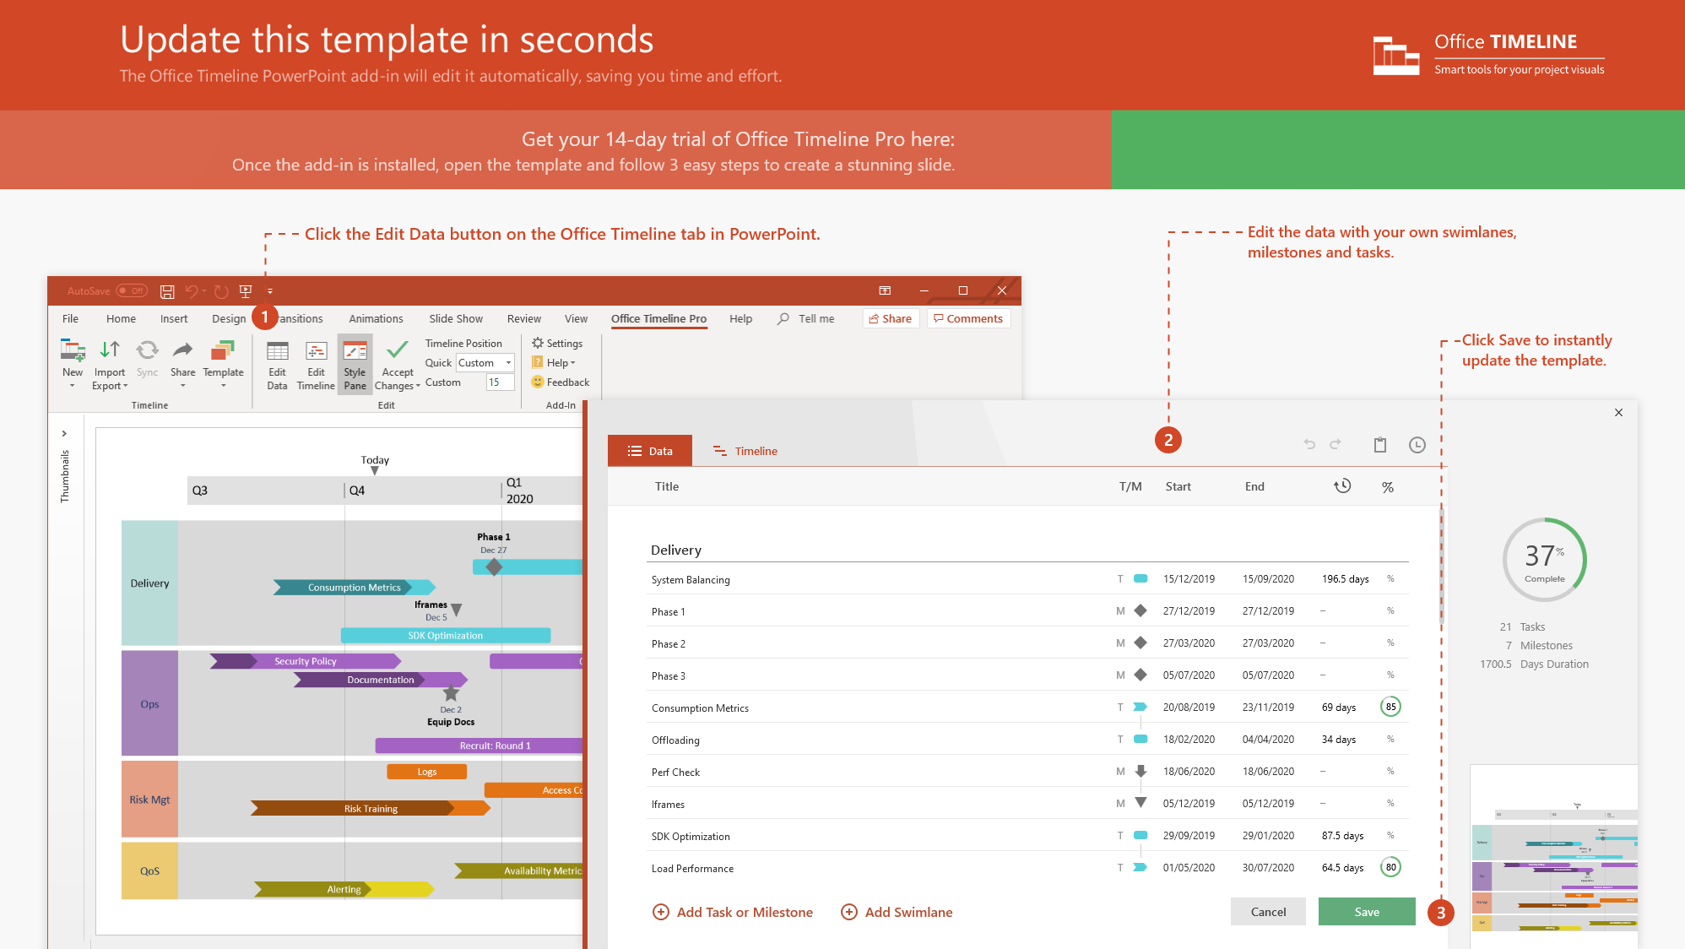
https://www.officetimeline.com/14-days-trial

Slide 2

Product portfolio roadmap
Today
2013
2014
2015
2016
2017
2018
2019
2020
2021
2022
2023
Decora 2013
Decora
Decora 2016
Decora 2020
Floral 2013
Regional Launches
Asia/Pacific
Europe
North America
South America
Floral
Floral 2015
Floral 2017
Arcade 2014
Arcade
Arcade 2018
Made with
Gamine
Gamine 2020

Slide 3
Equipment hourly schedule
Day 1
Day 2
8 am
10 am
12 pm
2 pm
4 pm
8 am
10 am
12 pm
2 pm
4 pm
Printer/Copy
Job P34
Job P35
Print shop
Wimbledon
Cutter
Job C25
Binder
Job B13
Laminator
Job L08
Printer/Copy
Job P36
Job P37
Print shop
Greenwich
Cutter
Job C26
Binder
Job B14
Laminator
Job L09
Printer/Copy
Job P38
Job P39
Print shop
Chelsea
Cutter
Job C27
Binder
Job B15
Made with
Laminator
Job L10

Slide 4
Ecommerce quarterly roadmap
Spring Collection
Back to School Sale
Winter Collection
Black Friday Sale
Feb 28
Aug 8
Oct 3
Nov 25
Q1
Q2
Q3
Q4
Jan
Feb
Mar
Apr
May
Jun
Jul
Aug
Sep
Oct
Nov
Dec
Improvements
Ruth Harper
Performance
Check out
Mobile app
Lillian Rowe
Product Image
Reporting
Digital Analytics
Merchandising
Patricia Lunn
Compliance
Automation
Supplier Evaluation
John Alloway
Instagram Ads
PR Campaign
Q3 & Q4 roadmap
Fashion Show
Marketing
Keith Henry
Product catalog
A/B Tests
Abandoned Cart Email
Arlene Blanco
SEO audit
SEO optimizations
Customer Experience
Stanley Parra
Login
Live Chat
Transfers
Robin Emerson
Email
Account
Details
Receipts
Mabel Fletcher
Database Improvements
Data Dump
Made with
Infrastructure
Ofelia Hamlin
Optimize Server
Update API Documentation

