Slide 1
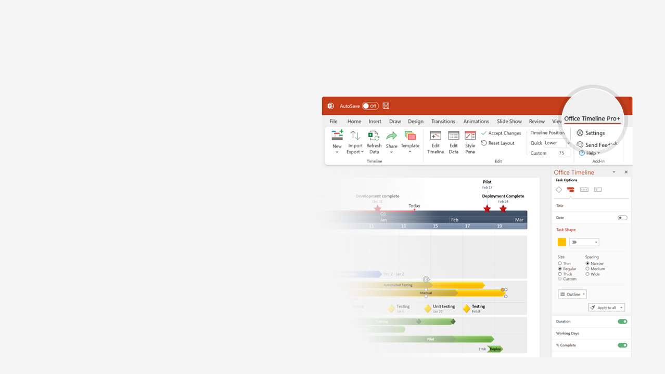

How to update this template in seconds
The Office Timeline add-in for PowerPoint will help you edit it with just a few clicks.
Get your free 14-day trial of Office Timeline here:
https://www.officetimeline.com/14-days-trial
Re-open this template, and create your impressive
PowerPoint visual in 3 easy steps:
1
Click the Edit Data button on the Office Timeline tab.
2
Use the Data and Timeline views to edit swimlanes, milestones and tasks.
3
Click Save to instantly update the template.

Slide 2
Clinical Trial Gantt chart
Apply for Drug Approval
Estimated Drug Approval Date
Report
Report
Oct 15 '22
Aug 10 '24
May 18 '25
Nov 11 '25
2022
2023
2024
2025
Jan
May
Sep
Jan
May
Sep
Jan
May
Sep
Jan
May
Sep
Patients
Recruited
Patients
Enrolled
Study
Kick-off
Stages
Recruitment
Enrollment
Kick-off
Modifications
Phase I
Feb 4 '22
Jun 3 '22
Sep 9 '22
Trial
18 mons
Jan 2022 - Jun 2023
Patients
Recruited
Patients
Enrolled
Study
Kick-off
Study
Modified
Phase II
Aug 3 '23
Dec 7 '23
Apr 4 '24
Jul 13 '24
Trial
19 mons
Jul 2023 - Feb 2025
Patients
Recruited
Patients
Enrolled
Study
Kick-off
Phase III
Oct 7 '24
Jan 31 '25
May 8 '25
Made with
Trial
13 mons
Sep 2024 - Oct 2025

Slide 3
EU Regulations for MDR and IVDR
Medicines & Healthcare Regulatory Agency CE Certificates Timeline
Regulations Enacted
MDR Fully Applies
IVDR Fully Applies
May 26, 2017
May 26, 2020
May 26, 2022
2017
2018
2019
2020
2021
2022
2023
2024
2025
May 2017 - May 2020
May 2020 - May 2024
May 2024 - Jun 2025
MDD
Certificates under Medical Device Directive (MDD) are valid
Certificates issued under MDD before MDR fully applies valid for up to 4 years
MDD devices on market continue to be made available
May 2017 - May 2024
May 2024 - Dec 2025
MDR
Devices in conformity with the Medical Device Regulation (MDR) can be certified under the MDR and placed on the market
Devices placed on market must be certified under MDR
May 2017 - May 2022
May 2022 - May 2024
May 2024 - May 2025
IVDD
Certificates issued under In Vitro Diagnostic Medical Device Regulation (IVDR) are valid
Certificates issued under IVDD before IVDR fully applies valid for up to 2 years
IVDR devices on market can continue to be made available
May 2017 - May 2024
May 2024 - Dec 2025
Made with
IVDR
Devices in conformity with the In Vitro Diagnostic Medical Device Regulation (IVDR) can be certified under the IVDR and placed on the market
Devices placed on market must be certified under IVDR

Slide 4
Pharmaceutical Product Discovery
Timeline for drug discovery, industry average.
Drug
Selection
IND
Submission
NDA
Submission
Approval
Feb 2019
Jul 2022
Dec 2027
Jan 2067
2018
2024
2030
2036
2042
2048
2054
2060
2066
Today
Availability
Lifecycle
Discovery
Pre-clinical
Clinical Trials
Licensing Approval
4.5 years
5.5 years
26.5 years
12.5 years
2.5 years
10K Candidates
2018 - 2022
20 Candidates
2022 - 2028
10 Candidates
2028 - 2035
Selection
2-5 Candidates
2035 - 2043
1-2 Drug Candidates
2043 - 2054
1 Drug
2054 - 2067
Made with
Reviews
Phase 1 Review
Phase 2 Review
Phase 3 Review
Dec 2034
Jul 2043
Jul 2054

Slide 5
International Pharma product launch timeline
2022
2023
Jan
Mar
May
Jul
Sep
Nov
Jan
Mar
Product
Alpha
United States
China
Japan
Germany
United Kingdom
India
Jan 20
Apr 28
Jul 4
Aug 15
Sep 28
Dec 8
Timeline
Product
Beta
United States
China
Japan
Germany
India
United Kingdom
Mar 1
May 14
Jul 1
Aug 12
Dec 5
Jan 15
Timeline
Product
Gamma
United States
China
Japan
Germany
United Kingdom
India
Apr 1
May 8
Jul 13
Sep 11
Oct 21
Nov 30
Timeline
Product
Delta
United States
China
Japan
Germany
United Kingdom
India
Made with
Apr 1
Jun 22
Aug 17
Nov 3
Dec 30
Mar 1
Timeline

