Slide 1
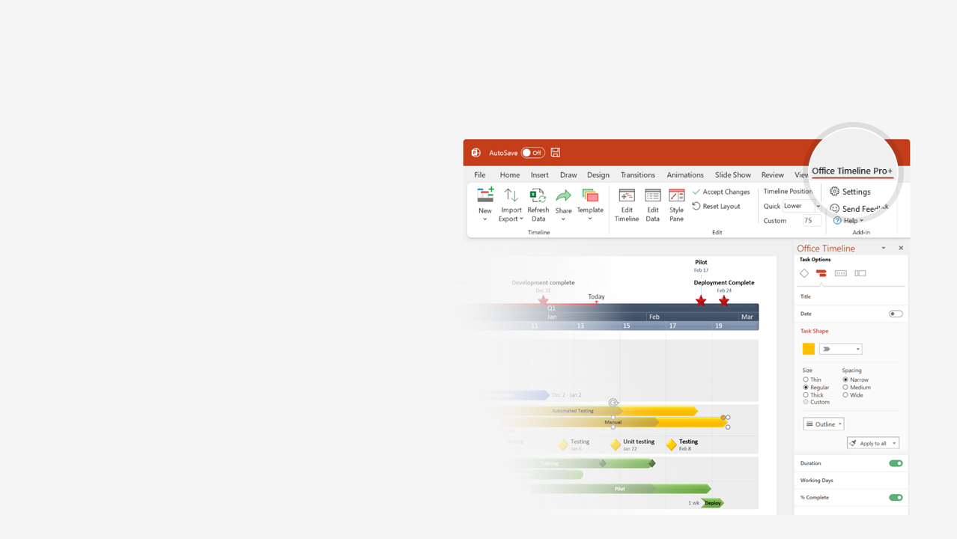

How to update this template in seconds
The Office Timeline add-in for PowerPoint will help you edit it with just a few clicks.
Get your free 14-day trial of Office Timeline here:
https://www.officetimeline.com/14-days-trial
Re-open this template, and create your impressive
PowerPoint visual in 3 easy steps:
1
Click the Edit Data button on the Office Timeline tab.
2
Use the Data and Timeline views to edit swimlanes, milestones and tasks.
3
Click Save to instantly update the template.

Slide 2
Timeline of Manufacturing Steps
2021
2022
2023
2024
2025
2026
2027
Planning
Design
Prototype
Design for Manufacturing
Kadenced
Manufacturing
Post-Manufacturing
Stages
Planning
Design
Prototype
Design for manufacturing
Manufacturing
Post-manufacturing
Planning
Design
Prototype
Design for Manufacturing
Rokkingham
Manufacturing
Post-Manufacturing
Commercial
Planning
Design
Prototype
Design for Manufacturing
Finits
Manufacturing
Post-Manufacturing
Planning
Design
Prototype
Design for Manufacturing
Manufacturing
Tracably
Post-Manufacturing
Planning
Design
Prototype
Design for Manufacturing
Overtaxez
Manufacturing
Post-Manufacturing
Planning
Design
Prototype
Design for Manufacturing
Moldirs
Manufacturing
Post-Manufacturing
Consumer
Planning
Design
Prototype
Design for Manufacturing
Manufacturing
Post-Manufacturing
Maculats
Planning
Design
Prototype
Design for Manufacturing
Made with
Twidge
Manufacturing
Post-Manufacturing

Slide 3
Site Production Roadmap
Today
2019
2020
2021
2022
2023
2024
2025
2026
2027
2028
2029
Product category
Display
Chips
Batteries
Assembly D1
LCD Elite
LCD Elite II
Future LCD Products
Austin
Assembly D2
LCD Basic
LCD Basic II
Assembly D3
Si 254
Si 255
Si 256
Seattle
Assembly C1
Si 700
Si 800
Si 900
Future Si Products
Assembly C2
Sx Alpha
Sx Beta
Sx Gamma
Seoul
Assembly S1
Si 254
Si 255
Si 256
Assembly S2
LI 9000
Future LCD Basic Products
Assembly T1
LI 8000
LI 9000
Taipei
Assembly T2
NiCd 11
NiCd 12
Made with
Assembly T3
Ak 100

Slide 4
Quarterly Lean Manufacturing Roadmap
V.0.0.2
MRR: 300K
V.0.0.3
IPO App v2 release
MRR: 300K
Q1
Q2
Q3
Q4
Jan
Feb
Mar
Apr
May
Jun
Jul
Aug
Sep
Oct
Nov
Dec
Funding deadline
Phase 1 Funding
Funding
deadline
Phase 2
Funding
Efficiency
Determine key stakeholders
Remove upgrade
barriers
Review current risk initiatives
Advertisement
management
Marketing
Analytical
marketing
Public
relations
Growth
Lean Manufacturing
Strategy
Total employee involvement
Total quality focus
Structured flow manufacturing
Growth
Level load and balanced flow
Set up reduction
Continuous improvement
Strategy
Analysis of feedback
Sales & Marketing reorganization
C-Level
Management
Change management
Made with
Efficiency
Culture overhaul
(switch to Agile)

