Slide 1
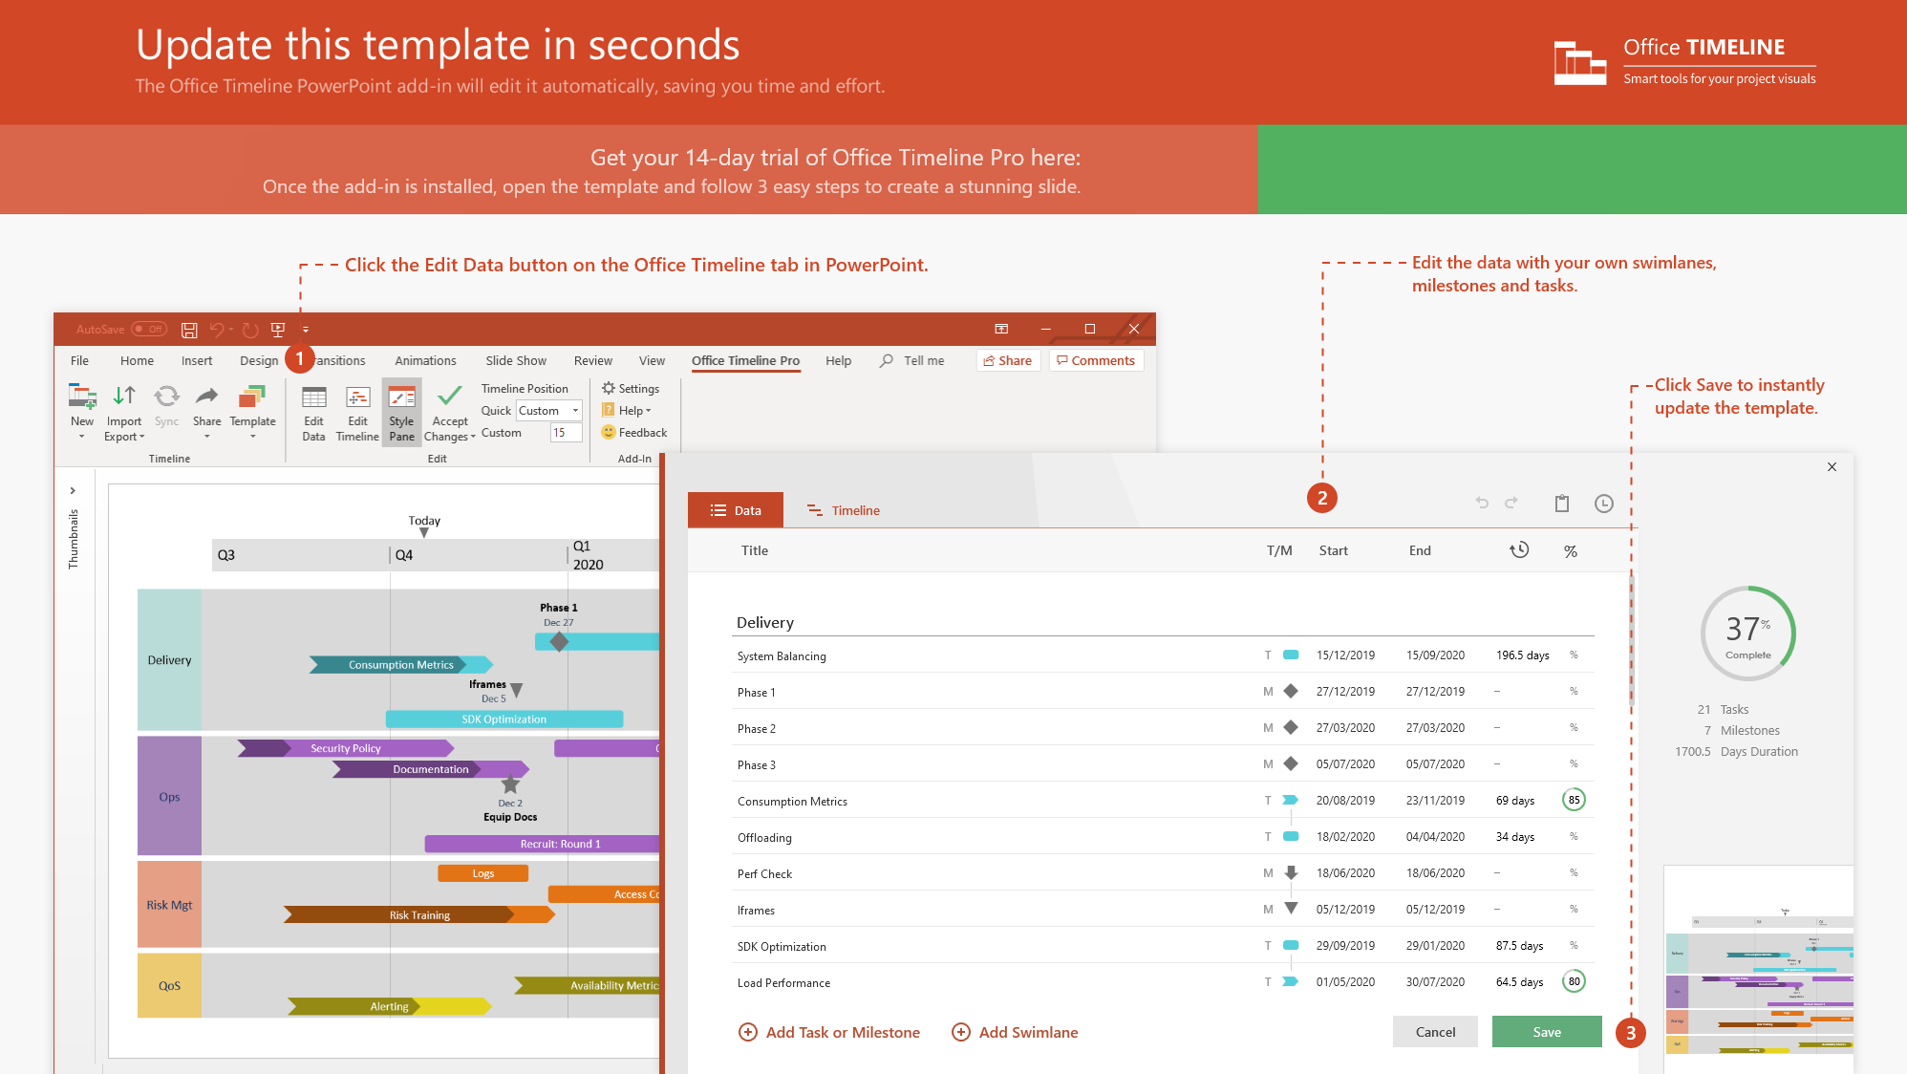
https://www.officetimeline.com/14-days-trial

Slide 2

Agile Task Board
Sprint 15 - Week of April 7
Sprint 16 - Week of April 14
Sprint 17 - Week of April 21
Mon
Wed
Fri
Sun
Tue
Thu
Sat
Mon
Wed
Fri
Status
Funded
Locked
Prioritized
Requested
Submitted
Product Reconciliation
Download PDF
Enhance Logo
Billing
Tax System Upgrade
Search by Invoice
Change Billing Address
Sox Audit 1
Communication Upgrade
Tax Page Organization
Reporting Upgrade
Datamart
Sales by Week/Representative
My Reports View
Fulfillment
Filter Orders
Vendor-suggest
Auto-email
Auto-discovery
Inventory
Multi-Tier
Middleware
Memory Upgrade
Multi-threading
Contact Database
Auto-notify
Portal
Request Status
Customer Home Page
Ticket Lookup
Auto-fill
Product-suggest
Customer Auto-quote
Quoting App
Setup Wizard
Undo-fill
Contract Tool
Clone Quote
Auto-remind
Quote Wizard
Custom Home Page
Made with
Workflow
Email Reminder
Auto-prioritize
Auto-assign
Aging Alerts

Slide 3
Server Outage Incident Timeline
Power
failure
Generator
exhausted
Power
restored
6:30 am
10:15 am
12:45 pm
Day 1
Day 2
Jun 21
0:00
2:00
4:00
6:00
8:00
10:00
12:00
14:00
16:00
18:00
20:00
22:00
0:00
Server 1
N
D
O
D
N
Houston
Site
Server 2
N
Hard Disk Failure
10:45 am
O
Server status
Normal
Degraded
Outage
Server 3
N
D
O
D
Memory Allocation Issue
11:52 am
N
Server 4
Memory Allocation Issue
11:38 am
N
D
O
D
N
Server 1
N
O
N
Denver
Site
Server 2
N
O
N
Server 3
N
O
N
Made with

Slide 4
Software Development Lifecycle (SDLC) Plan
2019
2020
2021
Q4
Q1
Q2
Q3
Q4
Q1
Q2
Q3
Oct
Dec
Feb
Apr
Jun
Aug
Oct
Dec
Feb
Apr
Jun
Aug
$17,600
100%
Requirements Analysis
Code Freeze
Code Freeze
Planning Phase
$52,800
100%
Software Design
Scope creep delays implementation
$4,000
Architect pulled into emergency production issue
Review
$126,720
Implementation
75%
Implementation Phase
$15,840
100%
Documentation
$4,000
Review
$21,120
Resources
Client
Product Management
Quality Assurance
Software Architects
Software Engineers
Technical Writers
Release Management
Unit Testing
$14,080
Add one QA resource to reduce unit testing elapsed time
Regression Testing
Testing Phase
$4,000
Review
Reduce bug fixing window (added risk)
$400
Beta Release
$17,600
Beta Phase
$21,120
Post-Beta Bug Fixes
Deployment Phase
$3,520
Regression Testing
Made with
$400
General Availability Release

Slide 5
Software Product Development Plan
2019
2020
2021
2022
Q3
Q4
Q1
Q2
Q3
Q4
Q1
Q2
Q3
Q4
Q1
Jul
Nov
Mar
Jul
Nov
Mar
Jul
Nov
Requirements Analysis
Phases
Requirements Analysis
Software Design
Implementation
Validation Testing
Deployment
Maintenance
Review
Software Design
Implementation
Validation Testing
Deployment
Release 4.3
Maintenance
100%
100%
100%
40%
Requirements Analysis
Software Design
Implementation
Validation Testing
Deployment
Orbital Product
Release 4.4
Maintenance
100%
75%
10%
Requirements Analysis
Software Design
Implementation
Validation Testing
Deployment
Release 4.5
Maintenance
30%
Requirements Analysis
Software Design
Implementation
Validation Testing
Deployment
Release 1.2
Maintenance
100%
100%
90%
Requirements Analysis
Software Design
Implementation
Validation Testing
Deployment
Allure Product
Release 1.3
Maintenance
100%
50%
Requirements Analysis
Software Design
Implementation
Validation Testing
Deployment
Release 1.4
Maintenance
Requirements Analysis
Software Design
Implementation
Validation Testing
Deployment
Release 1.9
Maintenance
100%
100%
75%
Requirements Analysis
Software Design
Implementation
Validation Testing
Deployment
Express Product
Release 2.0
Maintenance
100%
30%
Made with
Requirements Analysis
Software Design
Implementation
Validation Testing
Deployment
Release 2.1
Maintenance

