Slide 1
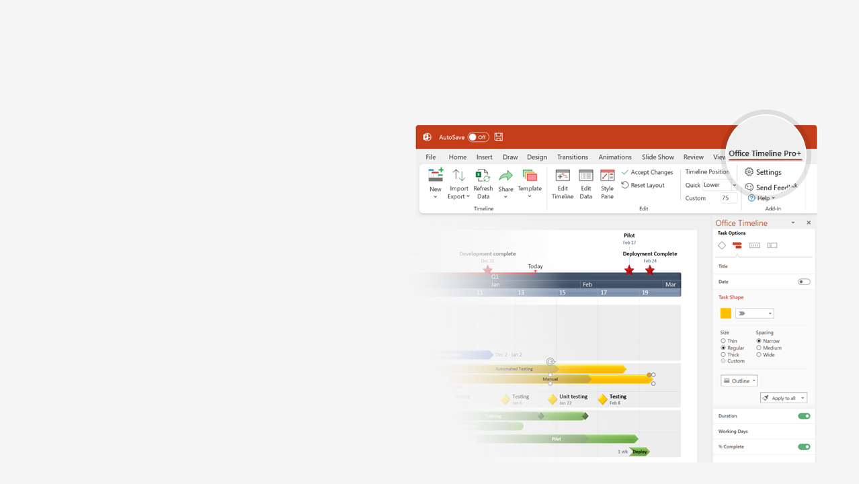

How to update this template in seconds
The Office Timeline add-in for PowerPoint will help you edit it with just a few clicks.
Get your free 14-day trial of Office Timeline here:
https://www.officetimeline.com/14-days-trial
Re-open this template, and create your impressive
PowerPoint visual in 3 easy steps:
1
Click the Edit Data button on the Office Timeline tab.
2
Use the Data and Timeline views to edit swimlanes, milestones and tasks.
3
Click Save to instantly update the template.

Slide 2
Hospital construction timeline
Occupancy
Today
Mar 20
2022
Feb
Apr
Jun
Aug
Oct
Dec
Feb
2023
Feb 1
General conditions & sitework
May 31
Resources
External Contractor
Prime Contractor
Medical Contractor
Dept. of Health
Feb 14
Concrete
Jun 30
Mar 1
Metals
Oct 31
Mar 1
Thermal and moisture protection
Oct 31
Apr 1
Mechanical
Dec 31
Apr 1
Electrical
Dec 31
May 1
Wood and plastics
Dec 31
Jun 1
Doors and windows
Dec 31
Jul 1
Finishes
Dec 31
Made with
Sep 1
Specialities
Feb 28
Sep 1
Equipment
Mar 31

Slide 3
Knee surgery recovery plan
Knee surgery
Full recovery
Jan
Feb
Mar
Apr
May
Jun
7 days
Manage pain with prescription painkillers
Legend
Painkillers
Mobility & Strength
ACL Recovery Exercises
Recovery
Week 1
7 days
Extension back to 100%
7 days
Walking without crutches
7 days
ACL recovery exercises
7 days
Manage pain with Tylenol or similar
Week 2
7 days
Improve flexion
7 days
Walking with improved limp
7 days
Increase intensity of ACL recovery exercises
Week 3
7 days
Start walking stairs
7 days
Start driving
Tylenol or similar as requested
Long-term
ACL recovery exercises - increase intensity as able
Jogging
Strength at 90% (no jumping)
Jumping exercises
Made with
Closure
Return to sport

Slide 4
Healthcare project timeline and work plan
2022
2023
Jun
Aug
Oct
Dec
Feb
Apr
Jun
Recruitment
Healthcare Aid Recruitment
Resident Recruitment
Mobility
Study
Sit-to-stand
Education & Reminders for Healthcare Aids
Activity Completed
Mobility
Measurement
Measurement
Measurement
Measurement
Measurement
Recruitment
Healthcare Aid Recruitment
Uptake Study with
Audit & Feedback
Resident Recruitment
Activity Completed
Sit-to-stand
Activity Flowsheets Monitored
Intervention
Site 1
Made with
Context Measure
Healthcare Aid Recruitment
& Completion of ACT

