Slide 1
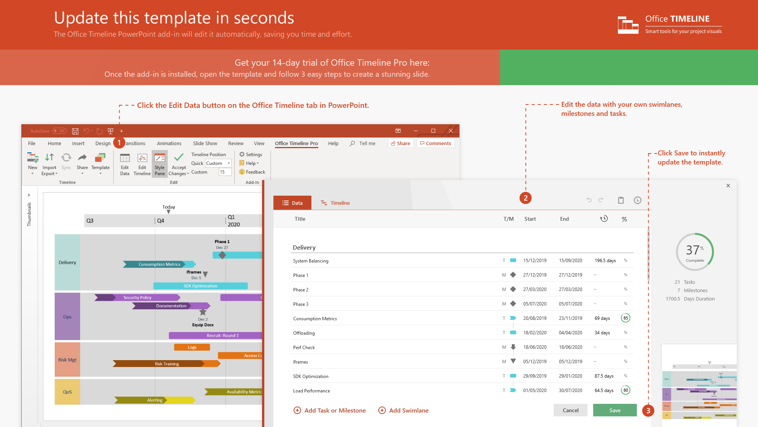
https://www.officetimeline.com/14-days-trial

Slide 2


Government Building Infrastructure Gantt chart
Project cycle overview
Completion
Jun 28
City of
Wellspring
Feb
Mar
Apr
May
Jun
Design and Planning
Preconstruction
Sample Approval
Contract Execution
Mobilization
Demo
Rough Framing
Structural repair
Construction
Inspection
Drywall
Painting
Trim
Finishes / Fixtures
Substantial Completion
Punch List
Close-Out
Final Inspection
Made with
Close-out Documents

Slide 3
Fire incident response timeline
Units Deployed
1 Unit
2-3 Units
4-6 Units
6-8 Units
in hours and minutes
Oct
01/10
02/10
03/10
04/10
05/10
06/10
07/10
08/10
19 Church Rd.
INC#022
16:00 - 20:36
Auto Fire
INC#025
50 Henry Ave.
21:04 - 23:41
1473 Layman Court
INC#002
14:08 - 21:44
8570 Lake Ave.
INC#007
08:12 - 15:13
Structure Fire
928 Trenton St.
INC#017
14:49 - 16:30
9886 Mayflower Ave.
INC#018
16:06 - 20:42
7939 Wild Horse Rd.
INC#029
14:53 - 00:24
Medical Emergency
350 Kirkland Court
INC#012
17:36 - 23:57
718 North Nut Swamp Street
INC#026
01:25 - 05:31
12 Victoria Dr.
INC#003
14:42 - 20:03
7467 Longbranch Street
INC#004
17:46 - 21:17
Traffic
Collision
482 Ivy Street
INC#006
04:29 - 06:35
1586 Adonais Way
INC#010
23:26 - 03:11
12 Gates Ave.
INC#011
04:45 - 05:29
Made with
7746 Taylor St.
INC#013
03:10 - 03:56

Slide 4
Transit Expansion Program Schedule
2016
2018
2020
2022
2024
2026
2028
2030
Campaign
Voter Approval
Phases
Central Corridor
Planning
Construction
Launch
Planning
Construction
Launch
60%
0%
East Corridor
Planning
Construction
Launch
100%
22%
North Corridor
Planning
Construction
Launch
40%
0%
South Corridor
Planning
Construction
Launch
35%
0%
West Corridor
Planning
Construction
Launch
100%
30%
Central Station
Planning
Construction
Launch
100%
10%
Made with
Diagonal BRT
Planning
Construction
Launch
100%
100%

