Slide 1
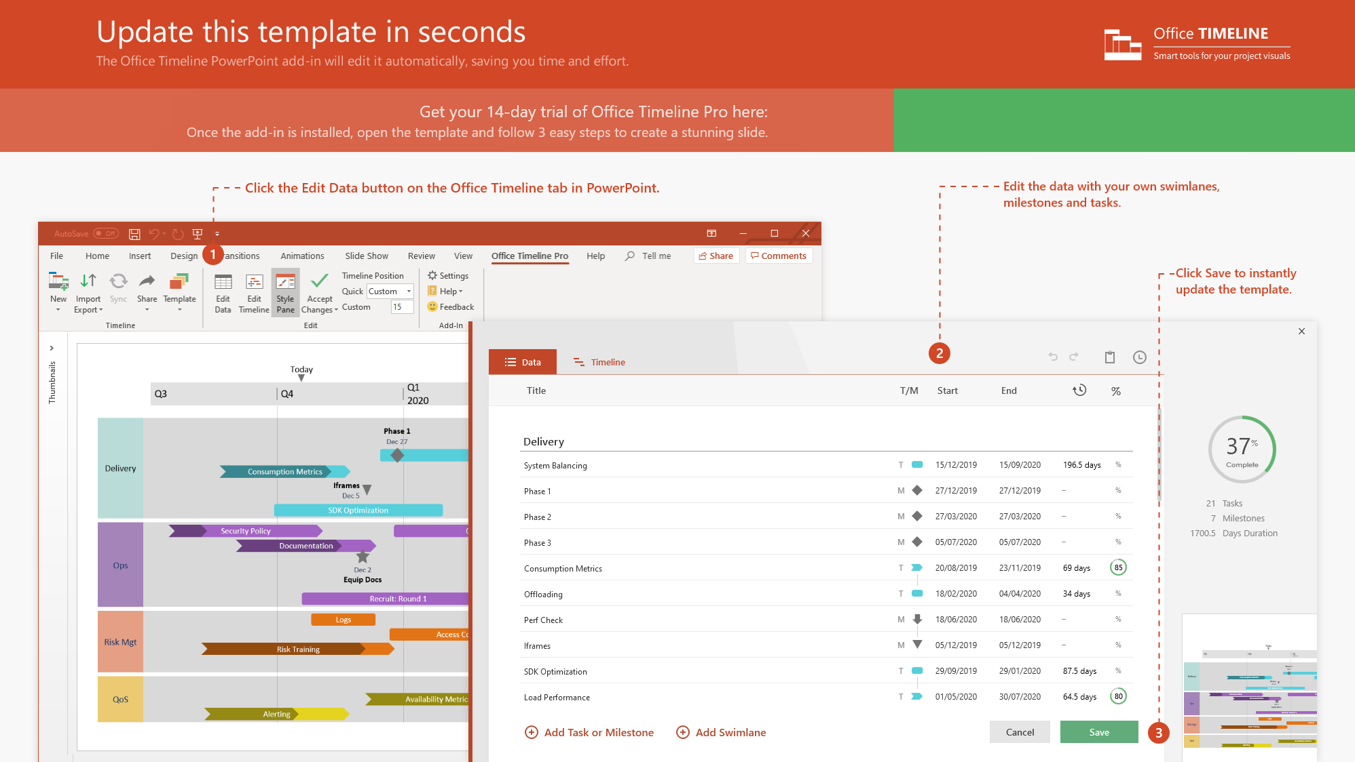
https://www.officetimeline.com/14-days-trial

Slide 2

TIMELINE RESUME EXAMPLE
Website of the Year Award
Outstanding App Award
Best Product Award
2010
2014
2018
2007
2009
2011
2013
2015
2017
2019
Foundation in Arts
Institute of Fine Arts
BA Graphic Design
London College of Art
PG Digital Business
University of London
MA Engineering
Ferris State University
EDUCATION
2007 - 2010
2010 - 2015
2015 - 2018
2018 - 2019
2010 - 2012
Junior Designer
Contoso, Ltd.
2012 - 2015
Senior Designer
Woodgrove Bank
CAREER
2015 - 2019
Senior Developer
VanArsdel, Ltd.
2017 - 2019
UX Designer
Relecloud

Slide 3
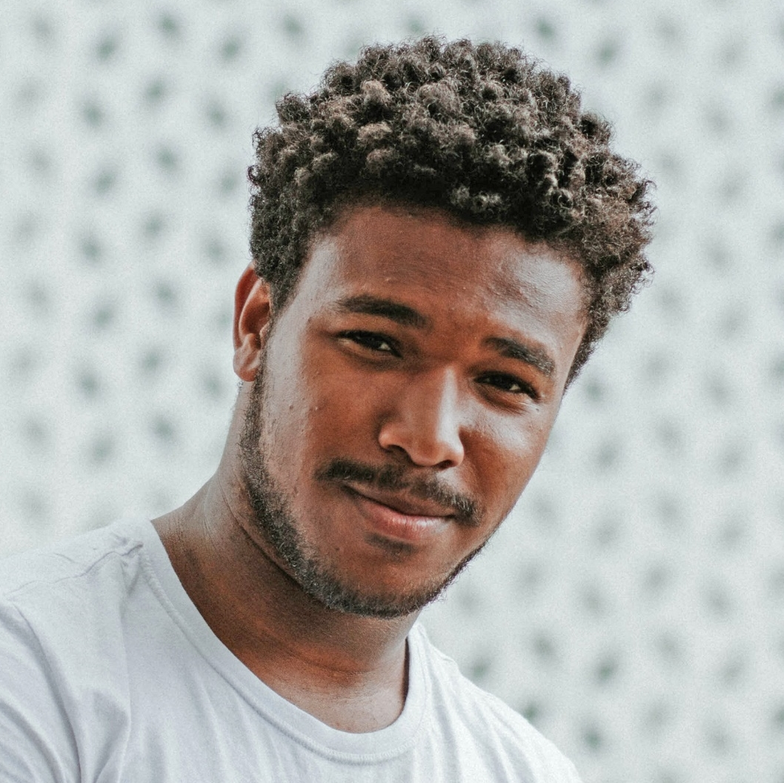










260.8 wks
156.4 wks
156.6 wks
221.8 wks
165.2 wks
134.6 wks
117.4 wks
52 wks
2007
2020
Today
IAN
HANSSON
BIO
ABOUT ME
SKILLS
816-555-0146
ian_hansson
Birth Date
16 June 1990
Designer with over 10 years of experience in app development and UI/UX. Expert with a variety of design and image processing tools. Owner of a Master’s Degree (Hons) in Engineering.
UI/UX Design
ian@example.com
Nationality
Swedish
Image Retouching
Graphic Designer, UI/UX Engineer
www.example.com
Location
Kansas City, USA
Front-End Coding
COMPLETED PROJECTS
LANGUAGES
HOBBIES
Back-End Coding
50
UI/UX Design
35
Branding Identity
15
English
French
German
Presentations
English
Website of the Year Award
Outstanding App Award
Best Product Award
2010
2014
2018
2007
2009
2011
2013
2015
2017
2019
Foundation in Arts
Institute of Fine Arts
BA Graphic Design
London College of Art
PG Digital Business
University of London
MA Engineering
Ferris State University
EDUCATION
2007 - 2010
2010 - 2015
2015 - 2018
2018 - 2019
Junior Designer
Contoso, Ltd.
Senior Designer
Woodgrove Bank
Senior Developer
VanArsdel, Ltd.
CAREER
2010 - 2012
2012 - 2015
2015 - 2019
UX Designer
Relecloud
2017 - 2019

