Slide 1
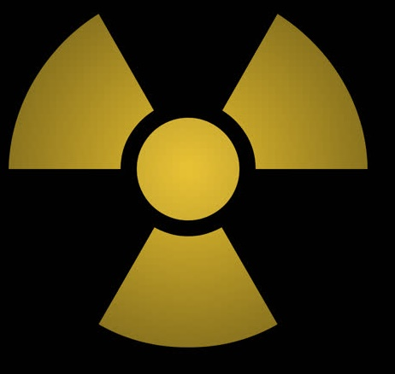
Explosion
Apr 26, 1:25 am
Officials shut down the other reactors
Apr 26, 5:00 am
Emergency core cooling system switched off
All fire extinguished, except inside Reactor 4
Apr 25, 2:00 pm
Apr 26, 6:35 am
A gov. committee, led by V. Legasov, is sent
Less-experienced night shift takes over the test
Apr 25, 11:11 pm
Apr 26, 8:00 pm
Apr 25
1 am
5 am
9 am
1 pm
5 pm
9 pm
1 am
5 am
9 am
1 pm
5 pm
Apr 26
Apr 25, 1:00 am
Apr 26, 6:00 am
Today
Akimov & Toptunov start manually turning valves to feed water into Reactor 4
Test on Reactor #4 begins (supervised by Dyatlov)
Apr 26, 1:35 am
Arrival of firefighters (no protective clothing)
Apr 25, 1:00 pm
Apr 26, 2:15 am
The reactor's power reduced to 50%
Local Soviet officials impose road block
Apr 26, 8:00 am
New shifts clock on at all four units
Apr 26, 1:23 am
Unexpected power surge occurs, control rods jam
Apr 26, 12:28 am
Control rods withdrawn against safety guidelines

