Slide 1
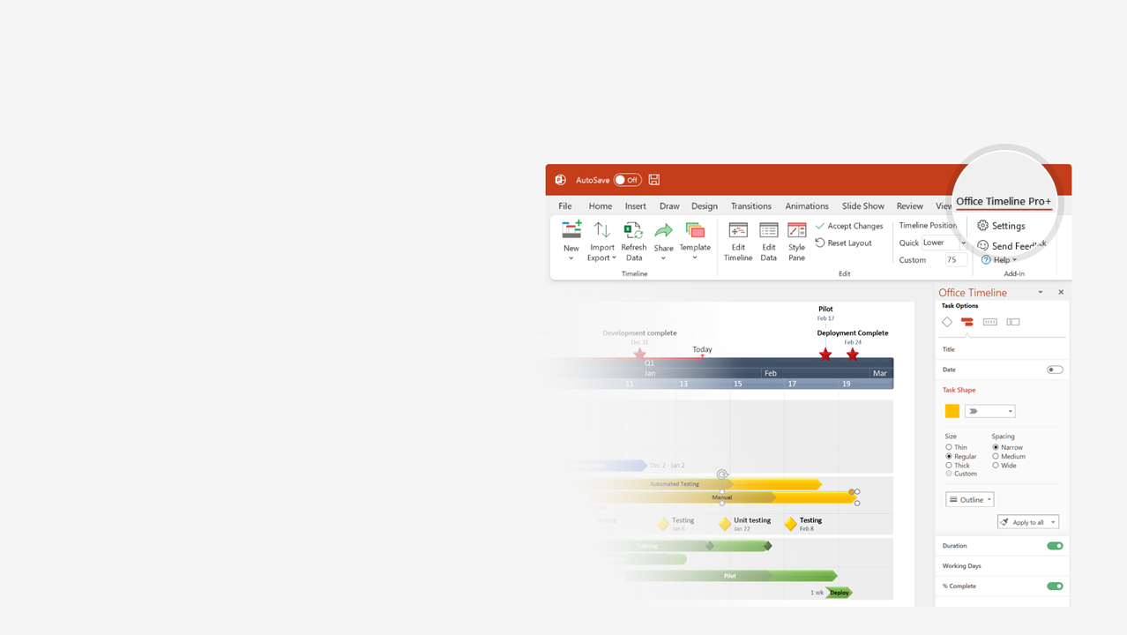

How to update this template in seconds
The Office Timeline add-in for PowerPoint will help you edit it with just a few clicks.
Get your free 14-day trial of Office Timeline here:
https://www.officetimeline.com/14-days-trial
Re-open this template, and create your impressive
PowerPoint visual in 3 easy steps:
1
Click the Edit Data button on the Office Timeline tab.
2
Use the Data and Timeline views to edit swimlanes, milestones and tasks.
3
Click Save to instantly update the template.

Slide 2
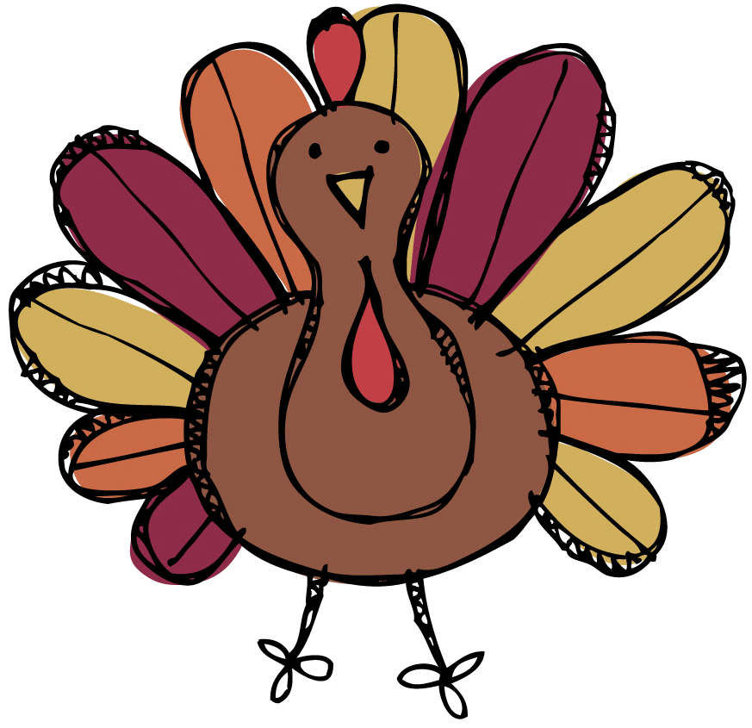

Early-bird Thanksgiving preparation timeline
2023
11/05
11/07
11/09
11/11
11/13
11/15
11/17
11/19
11/21
11/23
11/25
Sunday
Tuesday
Thursday
Saturday
Monday
Wednesday
Friday
Sunday
Tuesday
Thursday
Saturday
Confirm Guest List (RSVPs)
Decide the Menu
Prepare Shopping List
Mon Nov 6
Sun Nov 12
Fri Nov 17
Planning
Check Guests’
Dietary Requirements
Locate Cooking
Utensils
Inventory Dinnerware
and Plan Seating
Thu Nov 9
Mon Nov 13
Thu Nov 16
Pick a Centerpiece
Fri Nov 17
Purchase Beverages
Buy Hardy Vegetables
Shopping
Thu Nov 9
Sat Nov 18
Order Turkey
Shop for Heavy Cream
Mon Nov 13
Tue Nov 21
Stock Beverage Bar
Make Room in the
Refrigerator / Freezer
Prep Coat Racks with
Extra Hangers
Thu Nov 9
Sat Nov 18
Wed Nov 22
Prepping
Clean Linens / Silverware
Clean the House
Cut and Refrigerate
Veggies
Fri Nov 17
Sun Nov 19
Thu Nov 23
Table Arrangements / Centerpiece
Pick up the Turkey
Set the Tables / Chairs
Sat Nov 18
Wed Nov 22
Thu Nov 23
Cook the Pies / Breads / Biscuits
Thu Nov 23
Cooking
Prepare Sauces / Soups / Dips
Thu Nov 23
Store Casserole Ingredients
Thu Nov 23

Slide 3

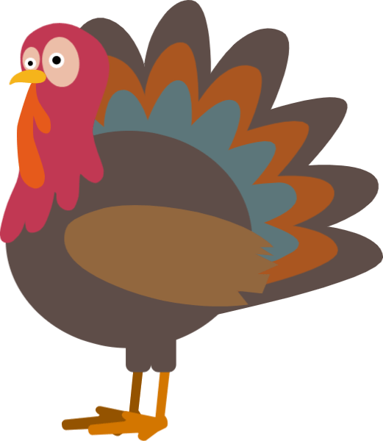


Thanksgiving dinner timeline: a race against the cluck
Take the turkey out of the fridge
Set the table
11:00 AM
3:00 PM
Put the turkey in the oven
Dinner is served!
11:30 AM
4:00 PM
8 am
9 am
10 am
11 am
12 pm
1 pm
2 pm
3 pm
4 pm
Peel & Chop
Fruits & Veggies
1.5 hours
Prep the Pumpkin
Pie Ingredients
30 m
Bake the Pumpkin Pie
30 m
Cook the Turkey
4 hours
Prep & Refrigerate Stuffing / Casseroles
30 m
Slow-Cook Mashed Potatoes
30 m
Prep the Gravy
30 m
Let the Turkey Rest
20 m

