Slide 1
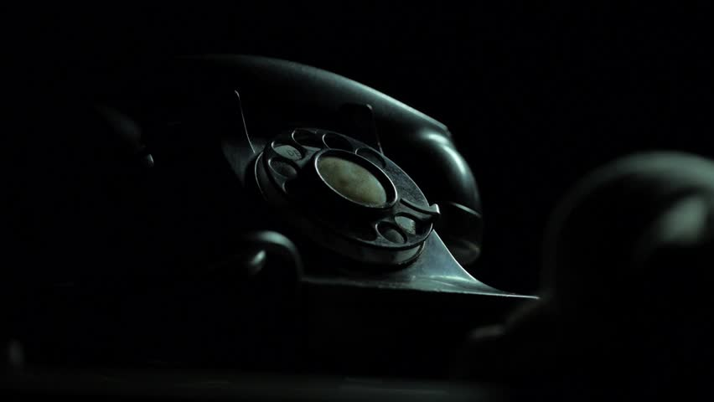
Touch-tone service launched, using push-button phones
1963
The first fully automatic mobile phone system
1981
Elisha Gray invents an electromagnet device that transmits musical tones
First camera cell phone
1872
2000
Alexander Bell patents the telephone
VoIP becomes mainstream
1876
2012
The first two-way telephone conversation (Bell and Watson)
Last manual switchboard is retired
2.32B smartphone users
October 9, 1876
1983
First pay phone
First tube shaft candlestick phone
GSM first deployed (Finland)
2017
1889
1904
1991
1872
1872
1893
1914
1935
1956
1977
1998
2018
1891
1982
2002
Today
1926
The rotary dial is invented
First transatlantic telephone call
Caller ID patented
First color cell phone
1877
1994
The first telephone line
First commercially available smartphone
1876
1941
1988
The first words ever spoken on a telephone (Bell to Watson)
Multi-frequency dialing
First transatlantic fiber optic cable
1875
1947
1973
Edison experiments with acoustic telegraphy
Introduction of area codes
First hand-held cell phone call

