Slide 1
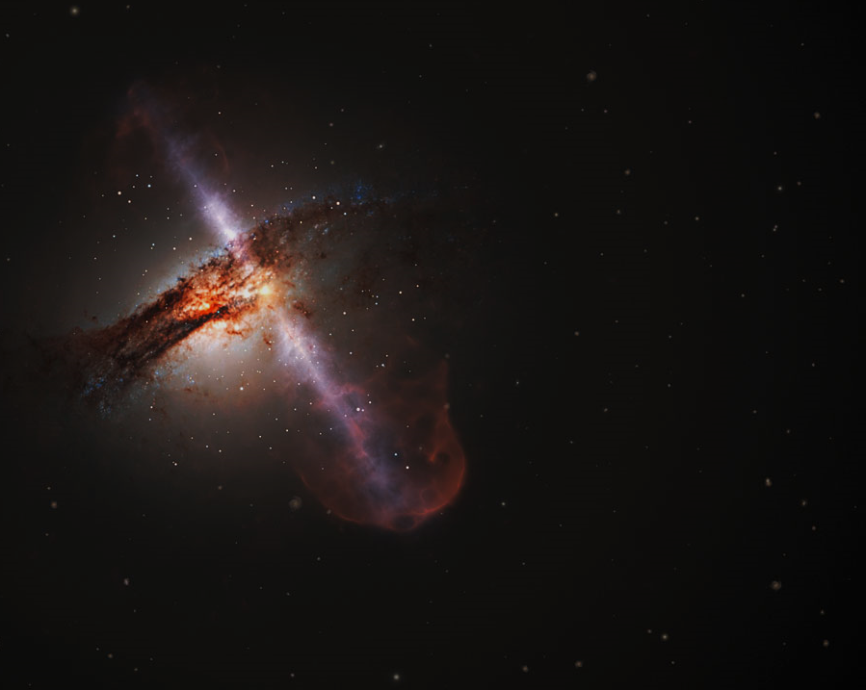
Begins studying physics at Oxford
1959
Discovers the second law of black hole dynamics
1970
Daughter, Lucy, is born
Divorces his wife and marries Elaine Masons
1970
1995
Publishes paper on Hawking Radiation
Publishes Information Loss in Black Holes
1975
2005
Diagnosed with ALS
Second son, Timothy, is born
Receives the Presidential Medal of Freedom
1963
1979
2009
Stephen Hawking is born
Receives his PhD at age 23
Publishes the Hartle-Hawking State model
Participates in a trial for iBrain
January 8, 1942
1966
1983
2011
1942
1942
1949
1956
1963
1970
1977
1984
1991
1998
2005
2012
2018
1952
1967
1988
2006
Today
March 14, 2018
Enrolls at St. Albans School
First son, Robert
A Brief History of Time is published
Divorces Elaine Mason
Dies peacefully in his home
1979
2010
Becomes Lucasian Professor at Cambridge
The Grand Design is published
1974
2001
Elected as a fellow of the Royal Society
The Universe in a Nutshell is published
1965
Marries Jane Wilde
1962
Starts graduate work at Cambridge

