Slide 1


How to update this template in seconds
The Office Timeline add-in for PowerPoint will help you edit it with just a few clicks.
Get your free 14-day trial of Office Timeline here:
https://www.officetimeline.com/14-days-trial
Re-open this template, and create your impressive
PowerPoint visual in 3 easy steps:
1
Click the Edit Data button on the Office Timeline tab.
2
Use the Data and Timeline views to edit swimlanes, milestones and tasks.
3
Click Save to instantly update the template.

Slide 2
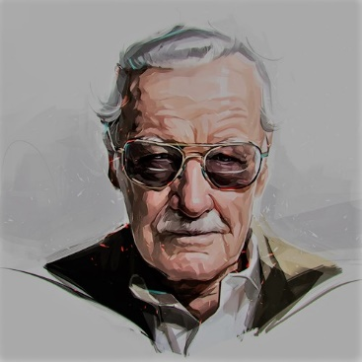

Stan Lee timeline
Stan Lee is born
Dies of heart and respiratory failure
December 28, 1922
November 12, 2018
1922
1935
1948
1961
1974
1987
2000
2013
Graduates from high school
Enters the US Army
The Inkpot Award
Founds Stan Lee Media
Hosts "Who Wants to Be a Superhero"
1939
1942
1974
1998
2006
Lee's comic book debut
Director of Marvel Comics
Moves to LA for Marvel's film projects
100 years since birth
1941
1972
1981
Dec 28, 2022
Stan Lee’s life
Becomes assistant at Timely Comics
Returns from military service
Co-founds POW! Entertainment
National Arts Medal
1939
1945
2001
2008
Marries Joan Clayton Boocock
Collaboration with Virgin Comics
Cameo appearance in Iron Man
1947
2008
2008
Stan Lee Foundation
Lifetime Achievement Award
2009
2012
1st superhero, The Destroyer
The Fantastic Four
Iron Man, Doctor Strange, X-Men
Superhero comics for Virgin Comics
1941
1961
1963
2008
Stan Lee’s superheroes
Hulk, Spider-Man, Thor, Loki
Daredevil, Wonder Man
The Zodiac Legacy: Convergence
1962
1963
2015
The Inhumans
Falcon
The Zodiac Legacy: The Dragon's Return
1965
1969
2016
Black Panther
Captain Marvel
The Zodiac Legacy: The Balance of Power
1966
1967
2017

