Slide 1
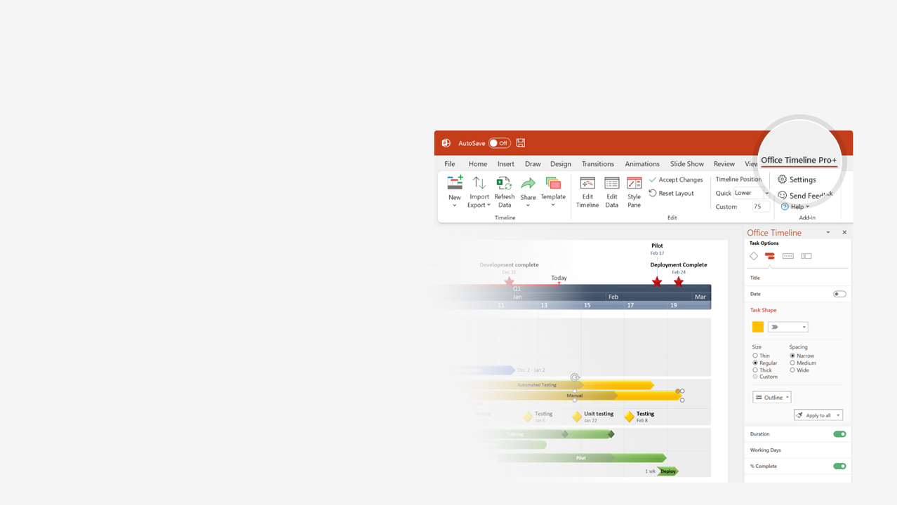

How to update this template in seconds
The Office Timeline add-in for PowerPoint will help you edit it with just a few clicks.
Get your free 14-day trial of Office Timeline here:
https://www.officetimeline.com/14-days-trial
Re-open this template, and create your impressive
PowerPoint visual in 3 easy steps:
1
Click the Edit Data button on the Office Timeline tab.
2
Use the Data and Timeline views to edit swimlanes, milestones and tasks.
3
Click Save to instantly update the template.

Slide 2
Scrum Sprint backlog
Sprint 15 - Week of April 7
Sprint 16 - Week of April 14
Sprint 17 - Week of April 21
Mon
Wed
Fri
Sun
Tue
Thu
Sat
Mon
Wed
Fri
Status
Funded
Locked
Prioritized
Requested
Submitted
Product Reconciliation
Download PDF
Enhance Logo
Billing
Tax System Upgrade
Search by Invoice
Change Billing Address
Sox Audit 1
Communication Upgrade
Tax Page Organization
Reporting Upgrade
Datamart
Sales by Week/Representative
My Reports View
Fulfillment
Filter Orders
Vendor-suggest
Auto-email
Auto-discovery
Inventory
Multi-Tier
Middleware
Memory Upgrade
Multi-threading
Contact Database
Auto-notify
Portal
Request Status
Customer Home Page
Ticket Lookup
Auto-fill
Product-suggest
Customer Auto-quote
Quoting App
Setup Wizard
Undo-fill
Contract Tool
Clone Quote
Auto-remind
Quote Wizard
Custom Home Page
Made with
Workflow
Email Reminder
Auto-prioritize
Auto-assign
Aging Alerts

