Slide 1
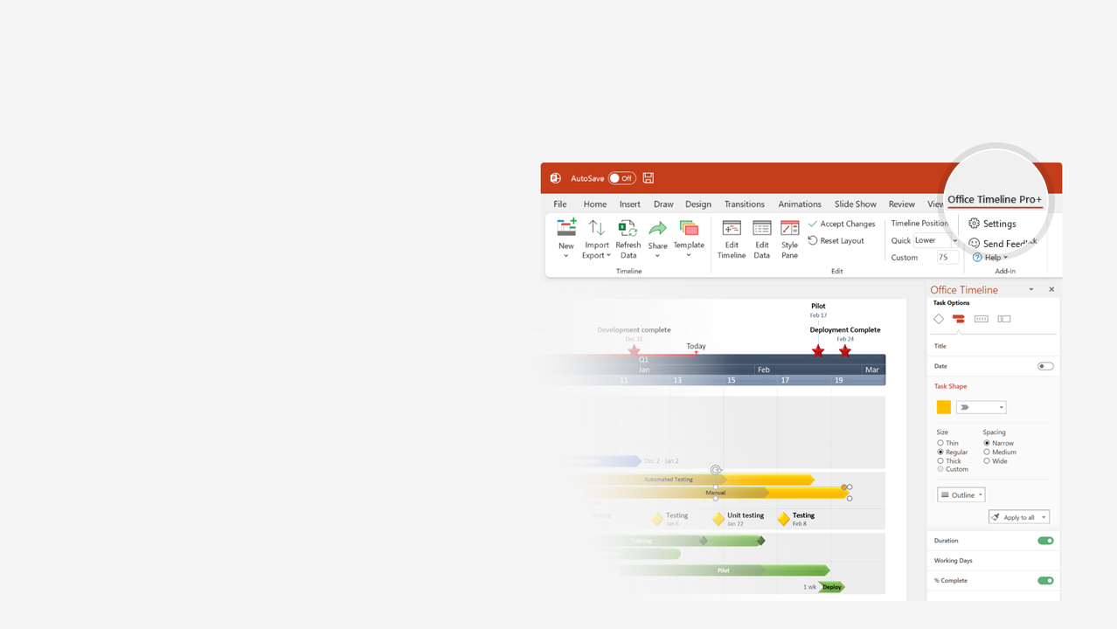

How to update this template in seconds
The Office Timeline add-in for PowerPoint will help you edit it with just a few clicks.
Get your free 14-day trial of Office Timeline here:
https://www.officetimeline.com/14-days-trial
Re-open this template, and create your impressive
PowerPoint visual in 3 easy steps:
1
Click the Edit Data button on the Office Timeline tab.
2
Use the Data and Timeline views to edit swimlanes, milestones and tasks.
3
Click Save to instantly update the template.

Slide 2

Scrum project roadmap
Strategic Goals
User Acquisition
Quarterly
Retrospective
Customer Delight
Release
Release
Adoption
Jan 28
Feb 25
Mar 25
Jan
Feb
Mar
Week 1
2
3
4
5
6
7
8
9
10
11
12
Jan 3 - Jan 14
Jan 17 - Jan 28
Jan 31 - Feb 11
Feb 14 - Feb 25
Feb 28 - Mar 11
Mar 14 - Mar 25
Sprint 1
Sprint 2
Sprint 3
Sprint 4
Sprint 5
Sprint 6
Customer Interviews
Demo v.1
Demo v.2
Team
Red
Shopping Cart
Tech Support Portal
Onboarding Flow
Data Logging Module
Functionality
Checkout Process
Back-End Upgrade
Update Navigation
Sensor Support
DB Configuration
Import Functionality
Demo Staging
Archiving
Team
Orange
Code Review
Admin Console
Auto Renewal System
Integrations Update
API
Ticketing System
Cloud support
Mobile Support
Update Colors
Mobile Enhancement
Bootstrap Upgrade
React Framework
Design Iteration
Team
Purple
Chrome Support
IE Support
Automated Tests
Status Update
Error Enhancements
Web App Overhaul
User Story
User Story 2
User Story 3
Undo Feature

