Slide 1
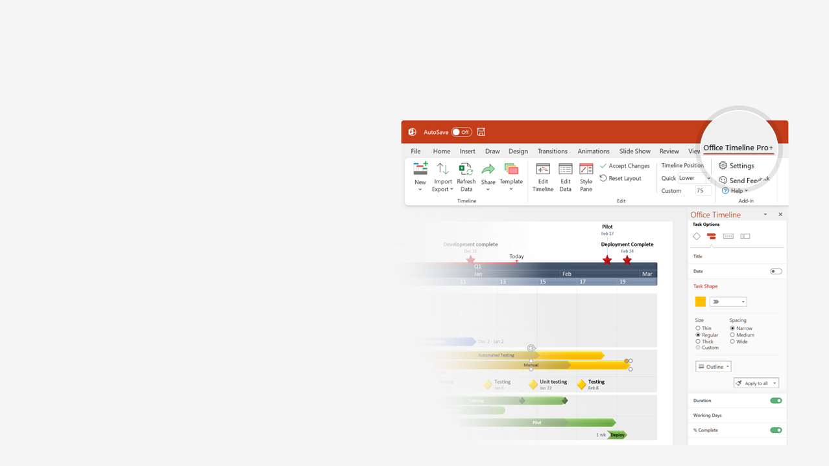

How to update this template in seconds
The Office Timeline add-in for PowerPoint will help you edit it with just a few clicks.
Get your free 14-day trial of Office Timeline here:
https://www.officetimeline.com/14-days-trial
Re-open this template, and create your impressive
PowerPoint visual in 3 easy steps:
1
Click the Edit Data button on the Office Timeline tab.
2
Use the Data and Timeline views to edit swimlanes, milestones and tasks.
3
Click Save to instantly update the template.

Slide 2


Project Management Conferences 2023
Q1
Q2
Q3
Q4
Jan
Feb
Mar
Apr
May
Jun
Jul
Aug
Sep
Oct
Nov
Dec
PMBA
Orlando, FL
Apr 3 - Apr 5
Boston, MA
Oct 16 - Oct 19
Washington, DC
Jun 12 - Jun 14
Chicago, IL
Nov 27 - Nov 29
RPS
St. Louis, MO
Jun 11 - Jun 14
CHG MGMT
Charlotte, NC
May 2 - May 3
IPMA
Bonita Springs, FL
Jun 4 - Jun 8
US
Agile 2023
Orlando, FL
Jul 24 - Jul 28
PMI Global Summit
Atlanta, GA
Oct 25 - Oct 28
Digital Summit
Phoenix, AZ
Mar 29 - Mar 30
Philadelphia, PA
Oct 16 - Oct 17
Washington, DC
Apr 18 - Apr 19
GSG
Portland, OR
May 7 - May 10
Canada
PMBA
Toronto
May 15 - May 18
Vancouver
Nov 13 - Nov 15
House of PMO
London
Jun 14 - Jun 15
Edinburgh
Nov 1 - Nov 2
UK
Future of PMO
London
Oct 26
AIPM
Sydney
Mar 24
Australia
PGCS
Canberra / Hybrid
Sep 22 - Sep 23
ICPM 2023
Sydney
Mar 27 - Mar 28
UMD
Online / UMD / Hybrid
Apr 20 - Apr 21
Online
CHG MGMT
Online
May 9 - May 12
China
IPMA
Nanjing
Apr 22 - Apr 23

