Slide 1
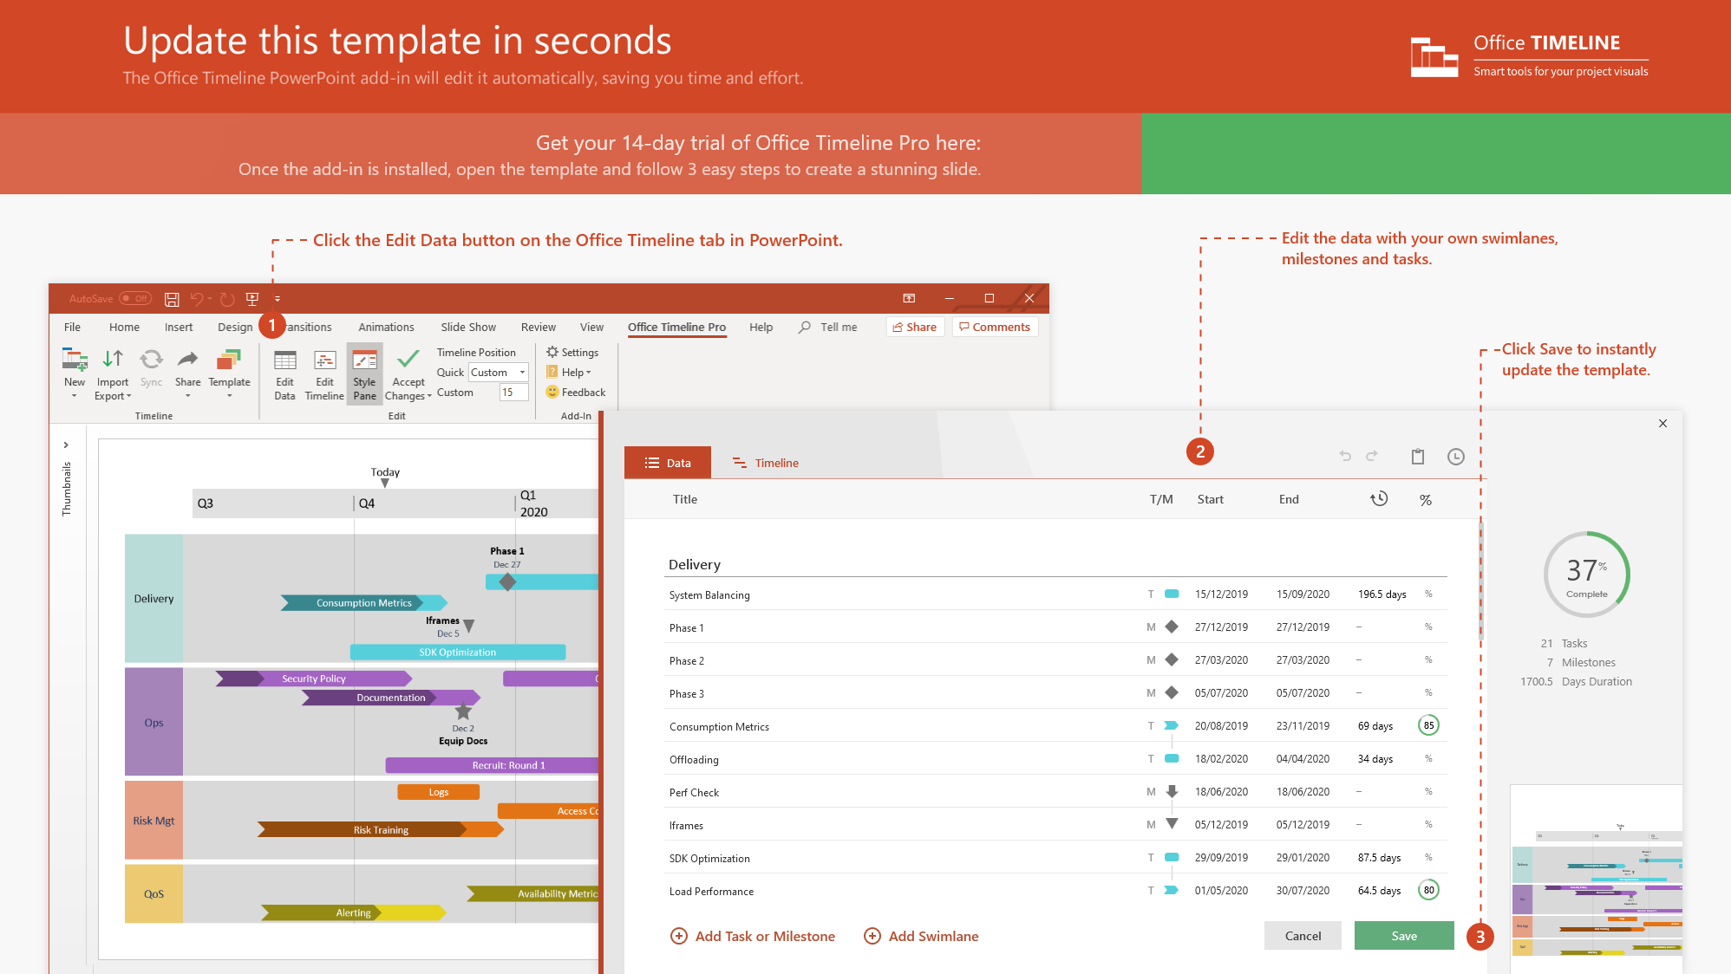
https://www.officetimeline.com/14-days-trial

Slide 2
Nov 2066 - Apr 2069
2018 - 2022
2022 - 2028
2028 - 2054
2054 - 2067
12.5 years
4.5 years
5.5 years
8.5 years
11 years
7 years
0%
0%
0%
0%
0%
0%
0%
0%
0%
0%
0%
Pharmaceutical Product Discovery
Timeline for drug discovery, industry average.
Drug Selection
Feb 2019
IND Submission
Jun 2022
NDA Submission
Approval
Dec 2027
Jan 2067
2018
2024
2030
2036
2042
2048
2054
2060
2066
2018
2071
Availability
Lifecycle
Today
Discovery
Pre-clinical
Clinical Trials
Licensing Approval
4.5 years
5.5 years
26.5 years
12.5 years
10K Candidates
2018 - 2022
2.5 years
20 Candidates
2022 - 2028
10 Candidates
2028 - 2035
Selection
2-5 Candidates
2035 - 2043
1-2 Drug Candidates
2043 - 2054
1 Drug
2054 - 2067
Reviews
Phase 1 Review
Phase 2 Review
Phase 3 Review
Dec 2034
Jul 2043
Jul 2054

