Slide 1
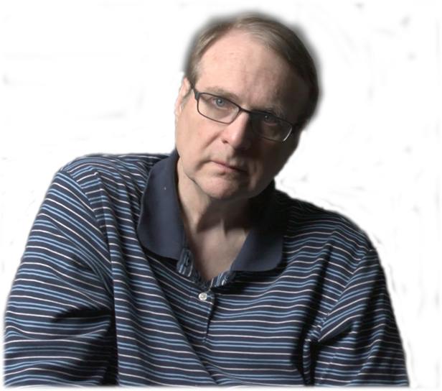

Resigns from Microsoft board
2000
Elected to the American Academy of Arts & Sciences
2010
Meets Bill Gates while at Lakeside School
Publishes "Idea Man" memoir
1968
2011
Drops out of the Univ. of Washington
Purchases the Seattle Seahawks NFL team
Founds the Allen Institute for Cell Science
1973
1996
2014
Paul Gardner Allen is born
Diagnosed with Hodgkin's lymphoma
The National Air & Space Museum Trophy
Dies of cancer
Jan 21, 1953
1982
2005
Oct 15, 2018
1953
1953
1959
1965
1971
1977
1983
1989
1995
2001
2007
2013
2018
1988
2015
Today
Purchases the Portland Trail Blazers NBA team
The Andrew Carnegie Medal of Philanthropy
1975
2013
Co-founds Microsoft
Founds the Allen Institute for AI
2011
Co-founds Stratolaunch Systems
2008
The Vanguard Award
2003
Founds the Allen Institute for Brain Science
2000
Releases music album Grown Men
Life events
Awards & recognition

