Slide 1
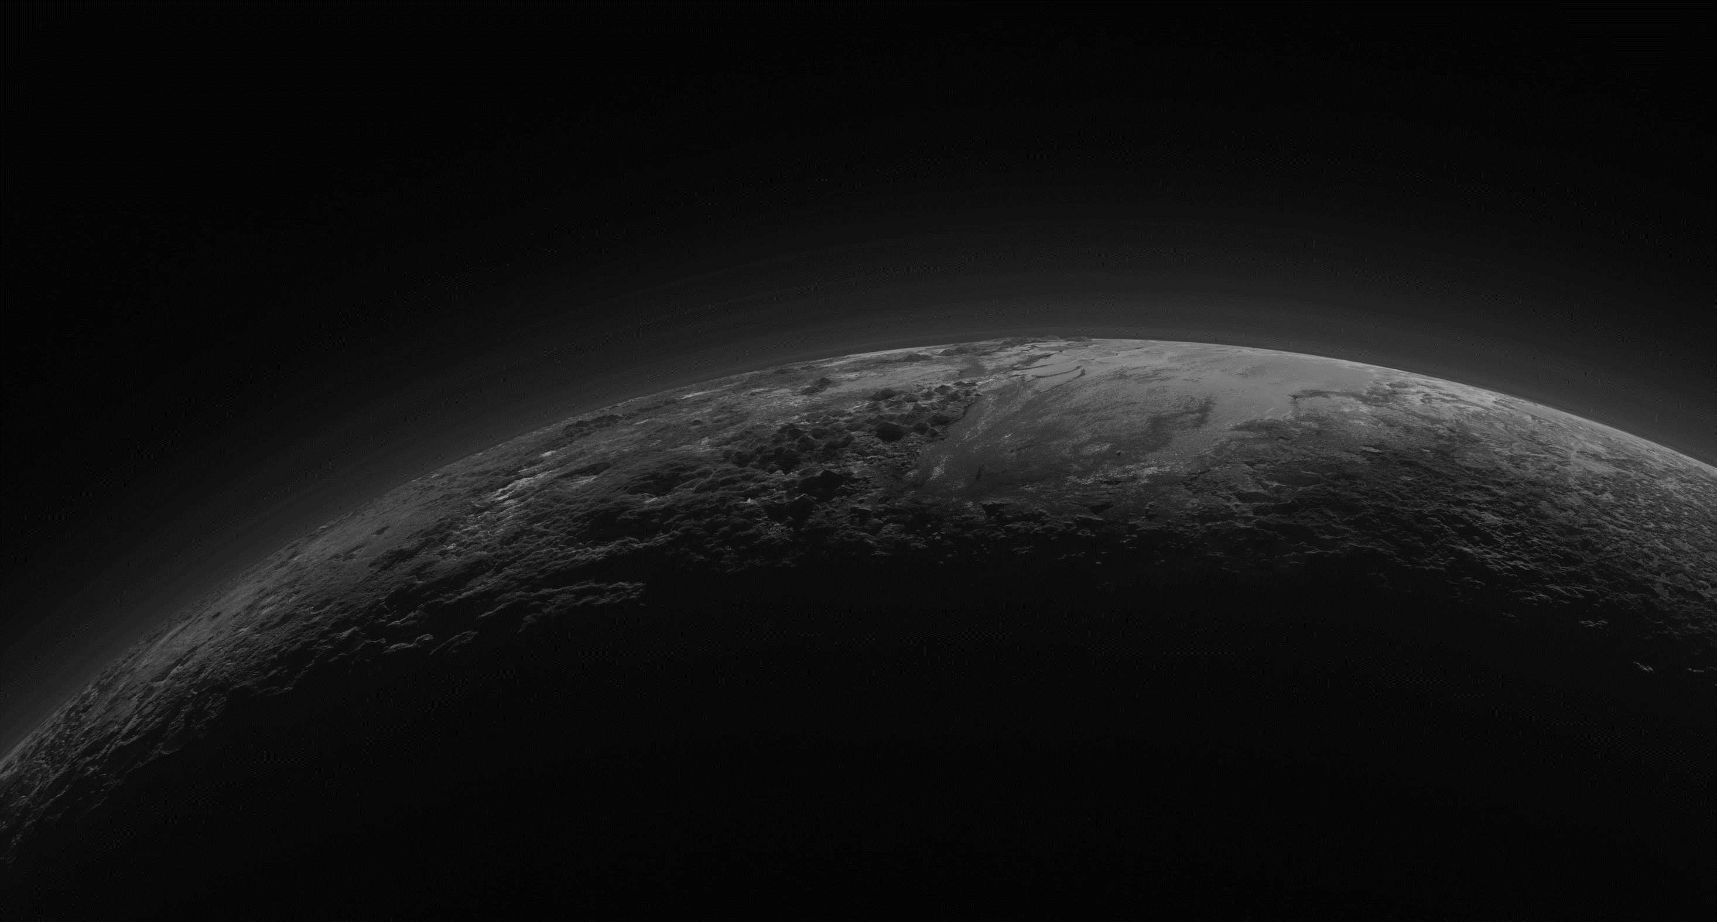
New Horizons launches
Neptune orbit crossing
January 19, 2006
August 25, 2014
First Pluto sighting
Halfway point to Pluto (distance travelled)
Pluto flyby (closest approach)
September 21, 2006
December 29, 2009
July 14, 2015
Jupiter flyby (gravity assist)
Uranus orbit crossing
Final wake-up from hybernation
Enters hybernation
February 28, 2007
March 18, 2011
December 6, 2014
April 7, 2017
First hybernation cycle started
Halfway point to Pluto (time travelled)
Mission extension confirmed
Planned flyby of MU69
June 28, 2007
October 16, 2011
July 1, 2016
January 1, 2019
2006
2006
2008
2010
2012
2014
2016
2018
2019
44 days
Today
Annual checkout 1
Sep 2007
Nov 2007
24 days
Annual checkout 2
Jul 2008
Aug 2008
23 days
Annual checkout 3
Jul 2009
Aug 2009
44 days
Annual checkout 4
May 2010
Jul 2010
45 days
Annual checkout 5
May 2011
Jul 2011
44 days
Annual checkout 6
May 2012
Jul 2012
67 days
Annual checkout 7
May 2013
Aug 2013
45 days
Annual checkout 8
Jun 2014
Aug 2014
1942 days
Jun 28, 2007
Hibernation
Dec 6, 2014
112 days
Hybernation
Apr 7, 2017
Sep 11, 2017

