Slide 1
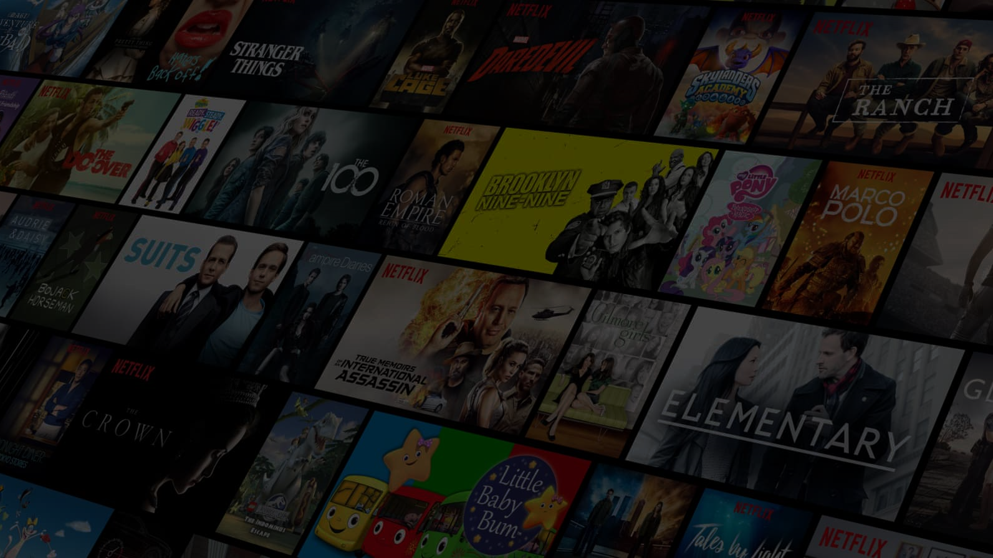
Starts expansion in Europe, launching in the UK and Ireland
Jan 2012
Netflix is founded
Starts streaming House of Cards
Aug 29 '97
Feb 2013
Participates in the "Internet Slowdown Day" protest
Introduces personalized movie recommendations
Sep 2014
Jun 2000
Partners with Univision to broadcast the first season of “Narcos”
Reaches 1 million subscribers
Apr 2003
May 2016
Raises $30 million in venture capital
Netflix delivers its billionth DVD
Announces "Profiles" feature
20-year anniversary
Jul 1999
Feb 2007
Aug 2013
Aug 29, 2017
1997
1997
2000
2003
2006
2009
2012
2015
2017
May 2002
Jan 2007
Dec 2012
Nov 2016
Today
Goes public at $15.00 per share
Introduces streaming
Massive Xmas Eve outage
Rolls out offline playback feature
Sep 1999
Sep 2010
Jan 2016
Launches its monthly subscription concept
Starts expanding internationally, beginning with Canada
Announces that it will launch originals targeting kids
Apr 1998
Sep 2015
Launches its website with 925 rentals available
Launches streaming service in Japan
Jul 2014
Announces a growth of 574% over the past five years
Jul 2013
Launches Orange Is the New Black
Company
Product

