Slide 1
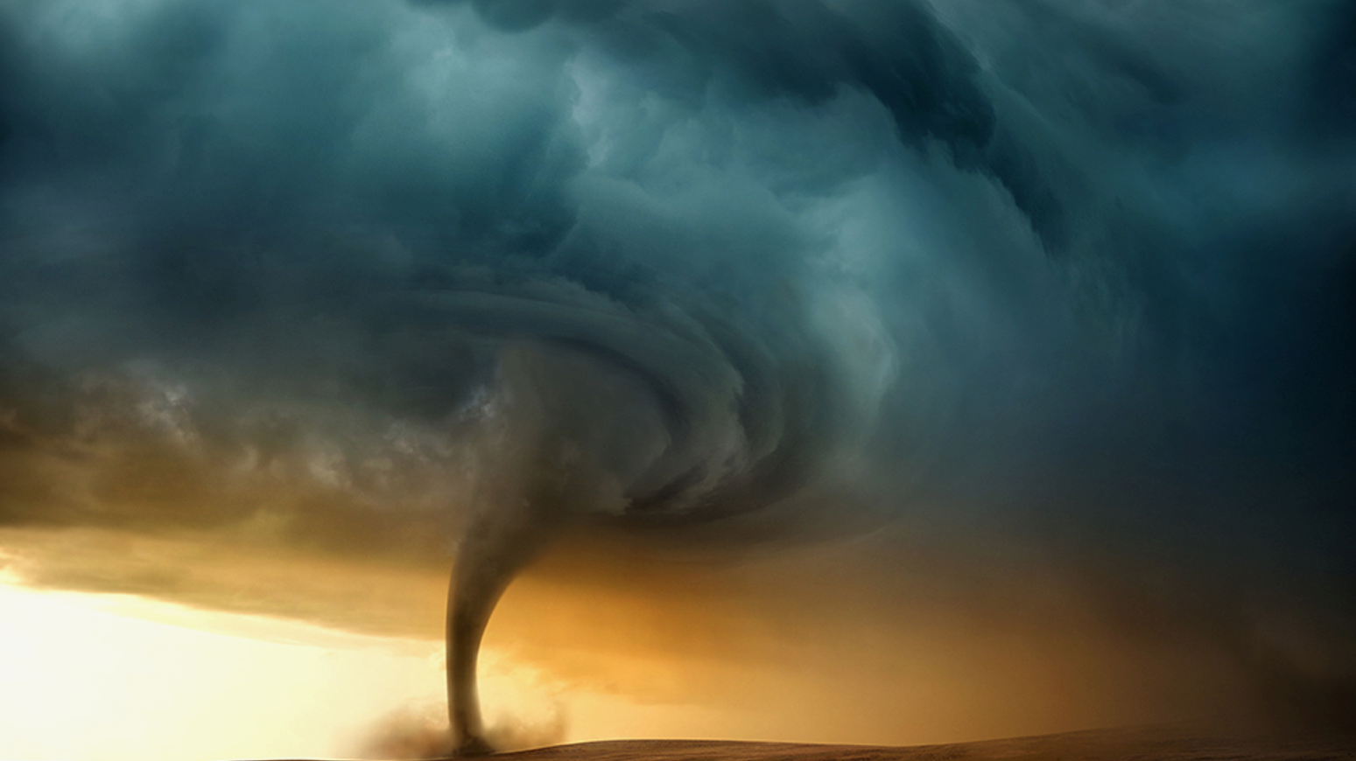

National Geographic Society is formed
Jan 13, 1888
National Geographic Channels International launches
1989
Alexander Graham Bell becomes president of NGS
NG publishes first article by Jacques-Yves Cousteau
National Geographic Trust is launched
Jan 7, 1898
1952
December 2001
Gilbert H. Grosvenor becomes president of NGS
Debut of NG TV programming on CBS
NGS opens its first global retail store
1920
1965
2008
First issue of NG magazine
First published natural-color aerial photos
National Geographic Traveler launches
Gary Knell becomes president of NGS
Oct 1888
1930
1984
2014
1888
1888
1899
1910
1921
1932
1943
1954
1965
1976
1987
1998
2009
2019
Jan 27, 1888
1941
1989
Today
Jan 13, 2018
NGS is officially incorporated
NGS provides cartographic data to the US army to aid war efforts
National Geographic Bee is launched
130th anniversary
1926
1969
2011
First natural-color underwater pictures
Apollo 11 carries the NGS flag to the moon
The Global Exploration Fund is launched
1903
1962
2003
Gilbert Hovey Grosvenor becomes editor of NG
First all-color issue of National Geographic
NG Speakers Bureau is formed
Jan 2001
National Geographic Channel launches in the US
Society
Publications & TV

