Slide 1
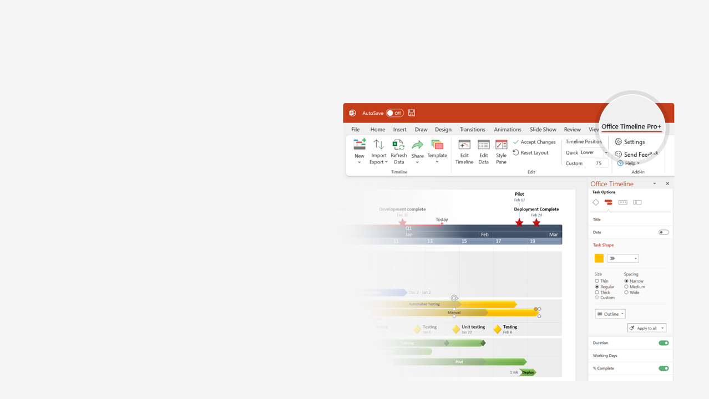

How to update this template in seconds
The Office Timeline add-in for PowerPoint will help you edit it with just a few clicks.
Get your free 14-day trial of Office Timeline here:
https://www.officetimeline.com/14-days-trial
Re-open this template, and create your impressive
PowerPoint visual in 3 easy steps:
1
Click the Edit Data button on the Office Timeline tab.
2
Use the Data and Timeline views to edit swimlanes, milestones and tasks.
3
Click Save to instantly update the template.

Slide 2

Microsoft Windows timeline
1985
1989
1993
1997
2001
2005
2009
2013
2017
2021
Windows 2.0
Windows 95
Windows ME
MS-DOS-
based versions
Dec 1987
Aug 1995
Sep 2000
Windows 1.0
Windows 3.0
Windows 98
Windows 98 SE
Nov 1985
May 1990
Jun 1998
May 1999
Windows
Server 2003
Windows
Home Server
Windows
Server 2008
Windows
Server 2016
Windows
Server 2019
Windows Server versions
Apr 2003
Nov 2007
Feb 2008
Sep 2016
Oct 2018
Windows
Home Server 2011
Windows
Server 2012
Windows
Server 2022
Apr 2011
Sep 2012
Aug 2021
Windows NT 3.5
Windows 2000
Windows XP
Windows 7
Windows 10
Client versions
Sep 1994
Feb 2000
Oct 2001
Oct 2009
Jul 2015
Windows NT 3.1
Windows NT 4.0
Windows Vista
Windows 8
Windows 11
Jul 1993
Aug 1996
Nov 2006
Oct 2012
Oct 2021
Windows CE 3.0
Windows CE 4.x
Windows CE 6.0
Embedded Compact 2013
Windows Embedded Compact
Apr 2000
Jan 2002
Feb 2007
Aug 2013
Windows CE 1.0
Windows CE 2.0
Windows CE 5.0
Embedded
Compact 7
Windows 10 IoT Enterprise
Nov 1996
Sep 1997
Jul 2004
Mar 2011
Jul 2015
Pocket PC 2000
Pocket PC 2002
Phone 7
Windows 10 Mobile
Mobile
and Phone
Apr 2000
Oct 2001
Nov 2010
Nov 2015
Mobile 2003
Mobile 5.0
Phone 8
Jun 2003
May 2005
Oct 2012

