Slide 1
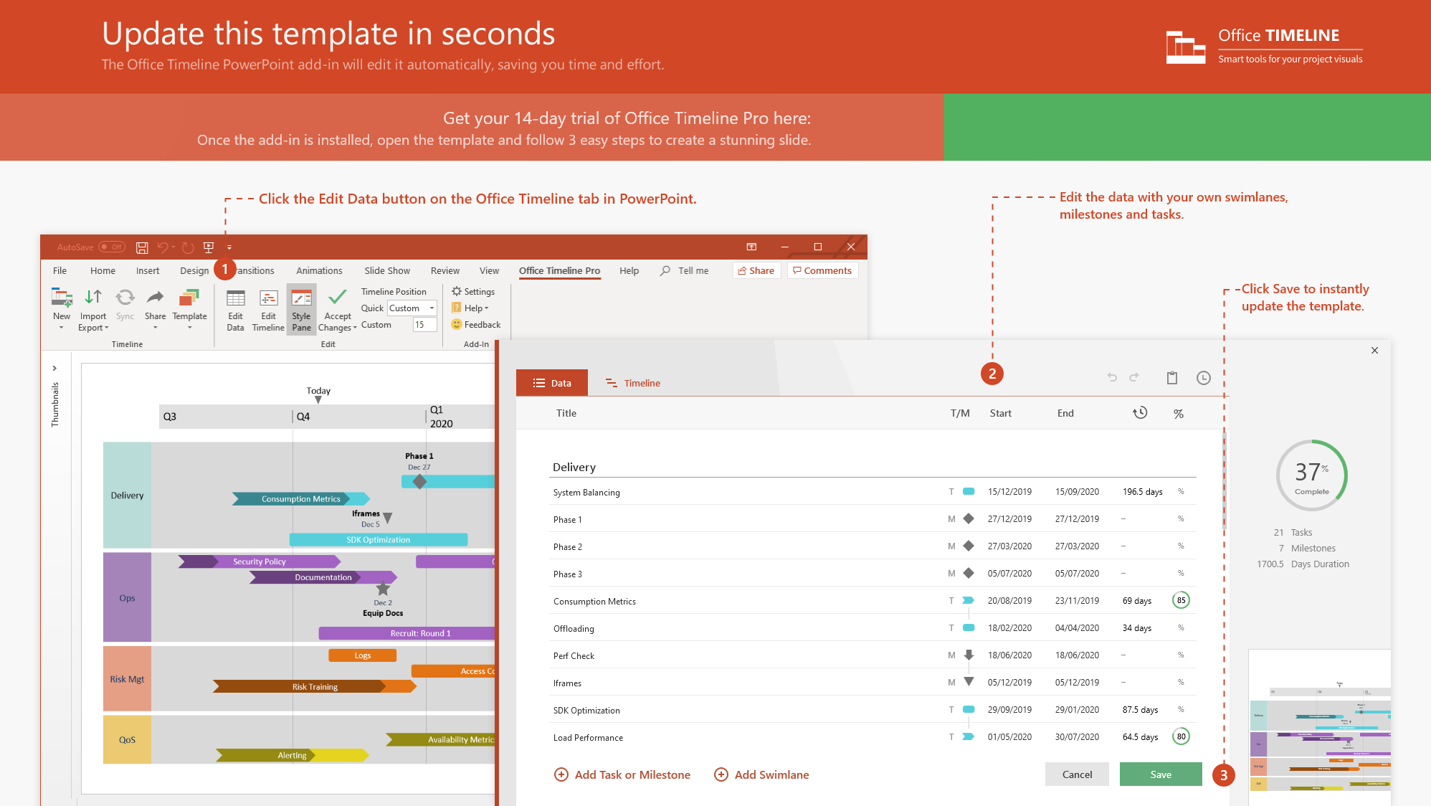
https://www.officetimeline.com/14-days-trial

Slide 2
1042.3 days
1824.4 days
1294.1 days
1824.2 days
281.9 days
777.9 days
409.2 days
525.6 days
255.9 days
412.7 days
2017
2025
Today
EU Regulations for MDR and IVDR
Medicines & Healthcare Regulatory Agency CE Certificates Timeline
Regulations Enacted
MDR Fully Applies
IVDR Fully Applies
May 26, 2017
May 26, 2020
May 26, 2022
2017
2018
2019
2020
2021
2022
2023
2024
2025
May 2017 - May 2020
May 2020 - May 2024
May 2024 - Jun 2025
MDD
Certificates under Medical Device Directive (MDD) are valid
Certificates issued under MDD before MDR fully applies valid for up to 4 years
MDD devices on market continue to be made available
May 2017 - May 2024
May 2024 - Dec 2025
MDR
Devices in conformity with the Medical Device Regulation (MDR) can be certified under the MDR and placed on the market
Devices placed on market must be certified under MDR
May 2017 - May 2022
May 2022 - May 2024
May 2024 - May 2025
IVDD
Certificates issued under In Vitro Diagnostic Medical Device Regulation (IVDR) are valid
Certificates issued under IVDD before IVDR fully applies valid for up to 2 years
IVDR devices on market can continue to be made available
May 2017 - May 2024
May 2024 - Dec 2025
IVDR
Devices in conformity with the In Vitro Diagnostic Medical Device Regulation (IVDR) can be certified under the IVDR and placed on the market
Devices placed on market must be certified under IVDR

