Slide 1
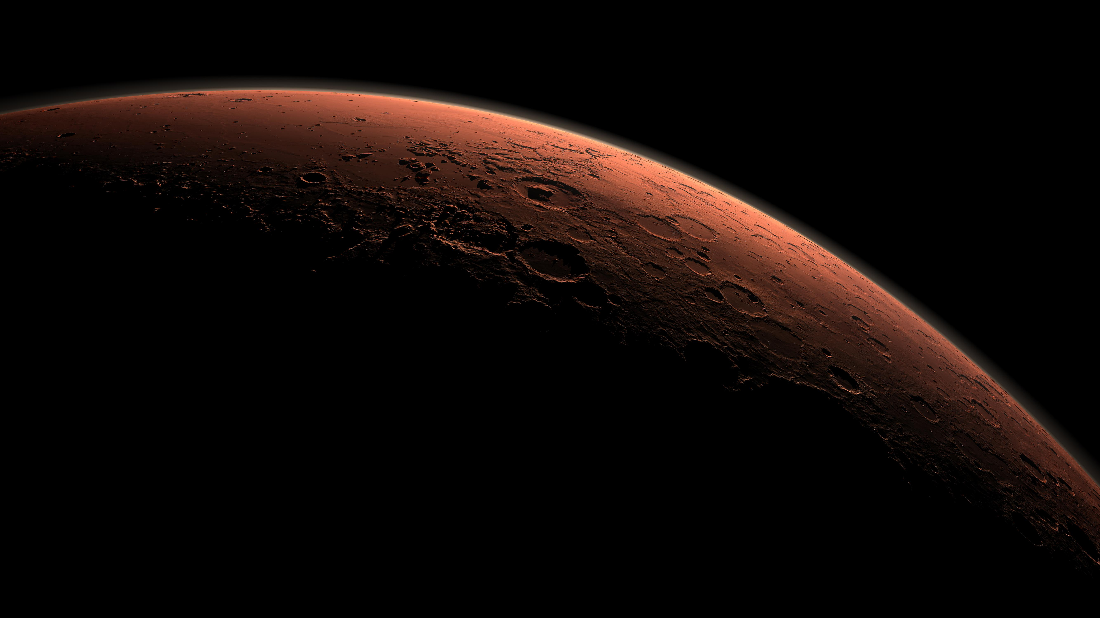
Mars Express
MRO
Mars Orbiter Mission
June 02, 2003
August 12, 2005
November 05, 2013
Mars Odyssey
Opportunity
Dawn
Yinghuo-1
ExoMars TGO
April 07, 2001
July 08, 2003
September 27, 2007
November 08, 2011
March 14, 2016
2001
2001
2003
2005
2007
2009
2011
2013
2015
2016
August 04, 2007
June 02, 2003
Phoenix
November 08, 2011
March 14, 2016
Beagle 2
Fobos-Grunt
Schiaparelli
June 10, 2003
November 26, 2011
Spirit
Curiosity
March 02, 2004
Rosetta
November 18, 2013
MAVEN

