Slide 1
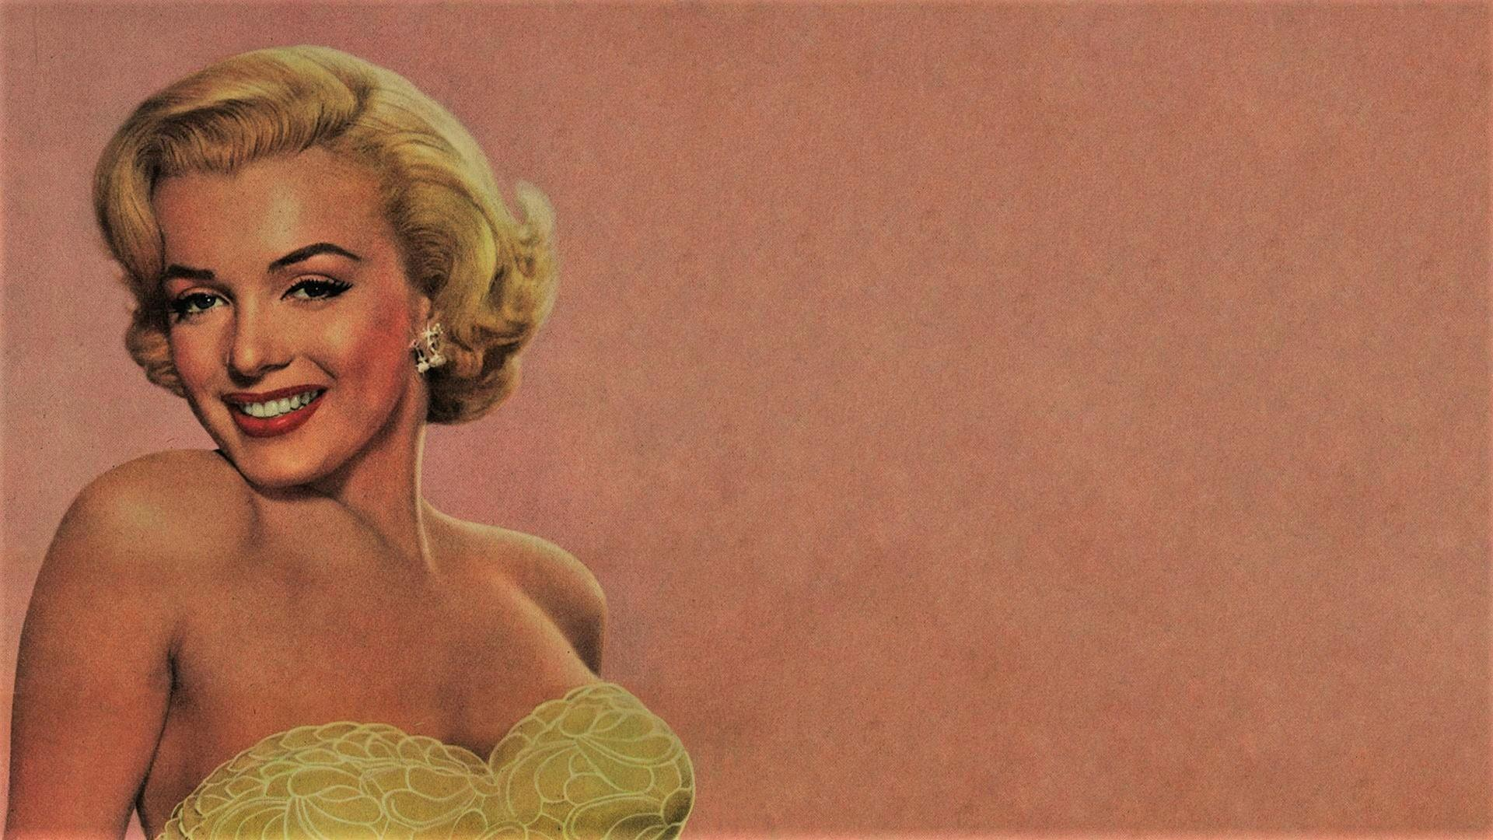
Presenter at the 23rd Academy Awards
1951
Gentlemen Prefer Blondes
1953
The Seven Year Itch
1954
The Prince and the Showgirl
1957
Marries to avoid returning to the orphanage
Some Like It Hot
1942
1958
Signs contract with modelling agency
Let's Make Love
1945
1960
Ladies of the Chorus
Maries Arthur Miller
Dies of barbiturate overdose
1948
1956
Aug 5, 1962
1926
1926
1930
1934
1938
1942
1946
1950
1954
1958
1962
1965
Today
1950
1956
1961
1927
1934
1941
Placed in foster care
Becomes ward of the state
Enrolls at Van Nuys High School
The Asphalt Jungle
Bus Stop
The Misfits
1946
1958
Jun 1, 1926
Signs contract with acting agency
Golden Globe for Best Actress
Norma Jeane Mortenson is born
1955
Founds her own production company
1954
Marries Joe DiMaggio
Life events
Movies

