Slide 1
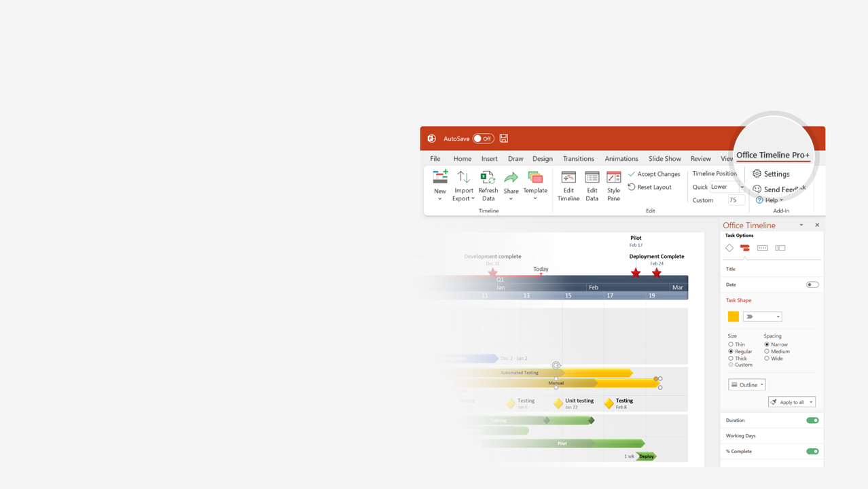

How to update this template in seconds
The Office Timeline add-in for PowerPoint will help you edit it with just a few clicks.
Get your free 14-day trial of Office Timeline here:
https://www.officetimeline.com/14-days-trial
Re-open this template, and create your impressive
PowerPoint visual in 3 easy steps:
1
Click the Edit Data button on the Office Timeline tab.
2
Use the Data and Timeline views to edit swimlanes, milestones and tasks.
3
Click Save to instantly update the template.

Slide 2


LinkedIn history timeline
Launched
Microsoft buys LinkedIn
May 5, 2003
Dec 2016
2002
2005
2008
2011
2014
2017
2020
1st month of profitability
Trades its first shares
43.6% drop in shares
False claim of leaked accounts
Company
Mar 2006
May 2011
Feb 2016
Apr 2021
Founded
Hacking attempt
Banned in Russia
Operations in China closed
Dec 2002
Jun 2012
Nov 2016
Nov 2021
1 million users
Office in India
Expands in China
830+ million members
Growth
Aug 2004
Dec 2009
Apr 2014
Apr 2022
10 million users
International headquarters in Dublin
500 million members
Apr 2007
Mar 2010
Apr 2017
LinkedIn for Groups
Profile views feature
Apply with LinkedIn feature
New mobile app
LinkedIn Events feature
Jul 2005
May 2007
Jul 2011
Oct 2015
May 2020
LinkedIn Business Accounts
Mobile version
Influencer program
LinkedIn Learning
Product
Aug 2005
Feb 2008
Oct 2012
Sep 2016
Introduces Endorsements
Analytics tool
Desktop website redesign
Sep 2012
May 2015
Jan 2017
Sponsored Updates ad service
Open for Business feature
Jul 2013
Nov 2019
mSpoke
Pulse
Lynda.com
Acquisitions
Aug 2010
Apr 2013
Apr 2015
SlideShare
Bright.com
May 2012
Feb 2014

