Slide 1
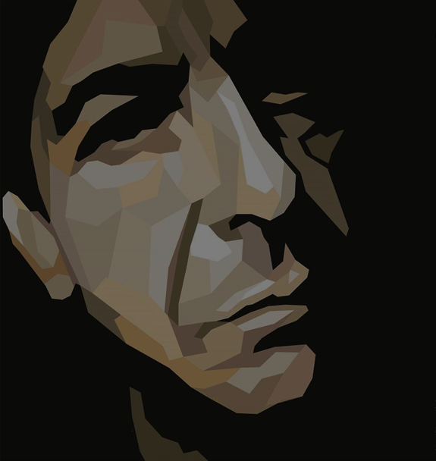
The Spice-Box of Earth (poems)
Retreats to Zen monastery for 5 years
1961
1994
Songs from a Room (album)
Ten New Songs (album)
1969
2001
Let Us Compare Mythologies (poems)
His 1st child is born
I'm Your Man (album)
The Prince of Asturias Award for literature
1956
1972
1988
2011
Leonard Cohen is born
Beautiful Losers (novel)
Recent Songs (album)
Named Companion of the Order of Canada
Dies
Sep 21, 1934
1966
1979
2003
Nov 7, 2016
1934
1934
1941
1948
1955
1962
1969
1976
1983
1990
1997
2004
2011
2017
Today
1963
1976
1996
2014
The Favourite Game (novel)
Goes on European tour
Ordained as a Rinzai Zen Buddhist monk
Popular Problems (album)
1967
1984
2006
'Songs of Leonard Cohen' (debut album)
Book of Mercy (poems)
Book of Longing (poems & drawings)
1971
2002
Songs of Love and Hate (album)
Canadian Juno award for Best Artist
1993
Stranger Music: Selected Poems and Songs

