Slide 1
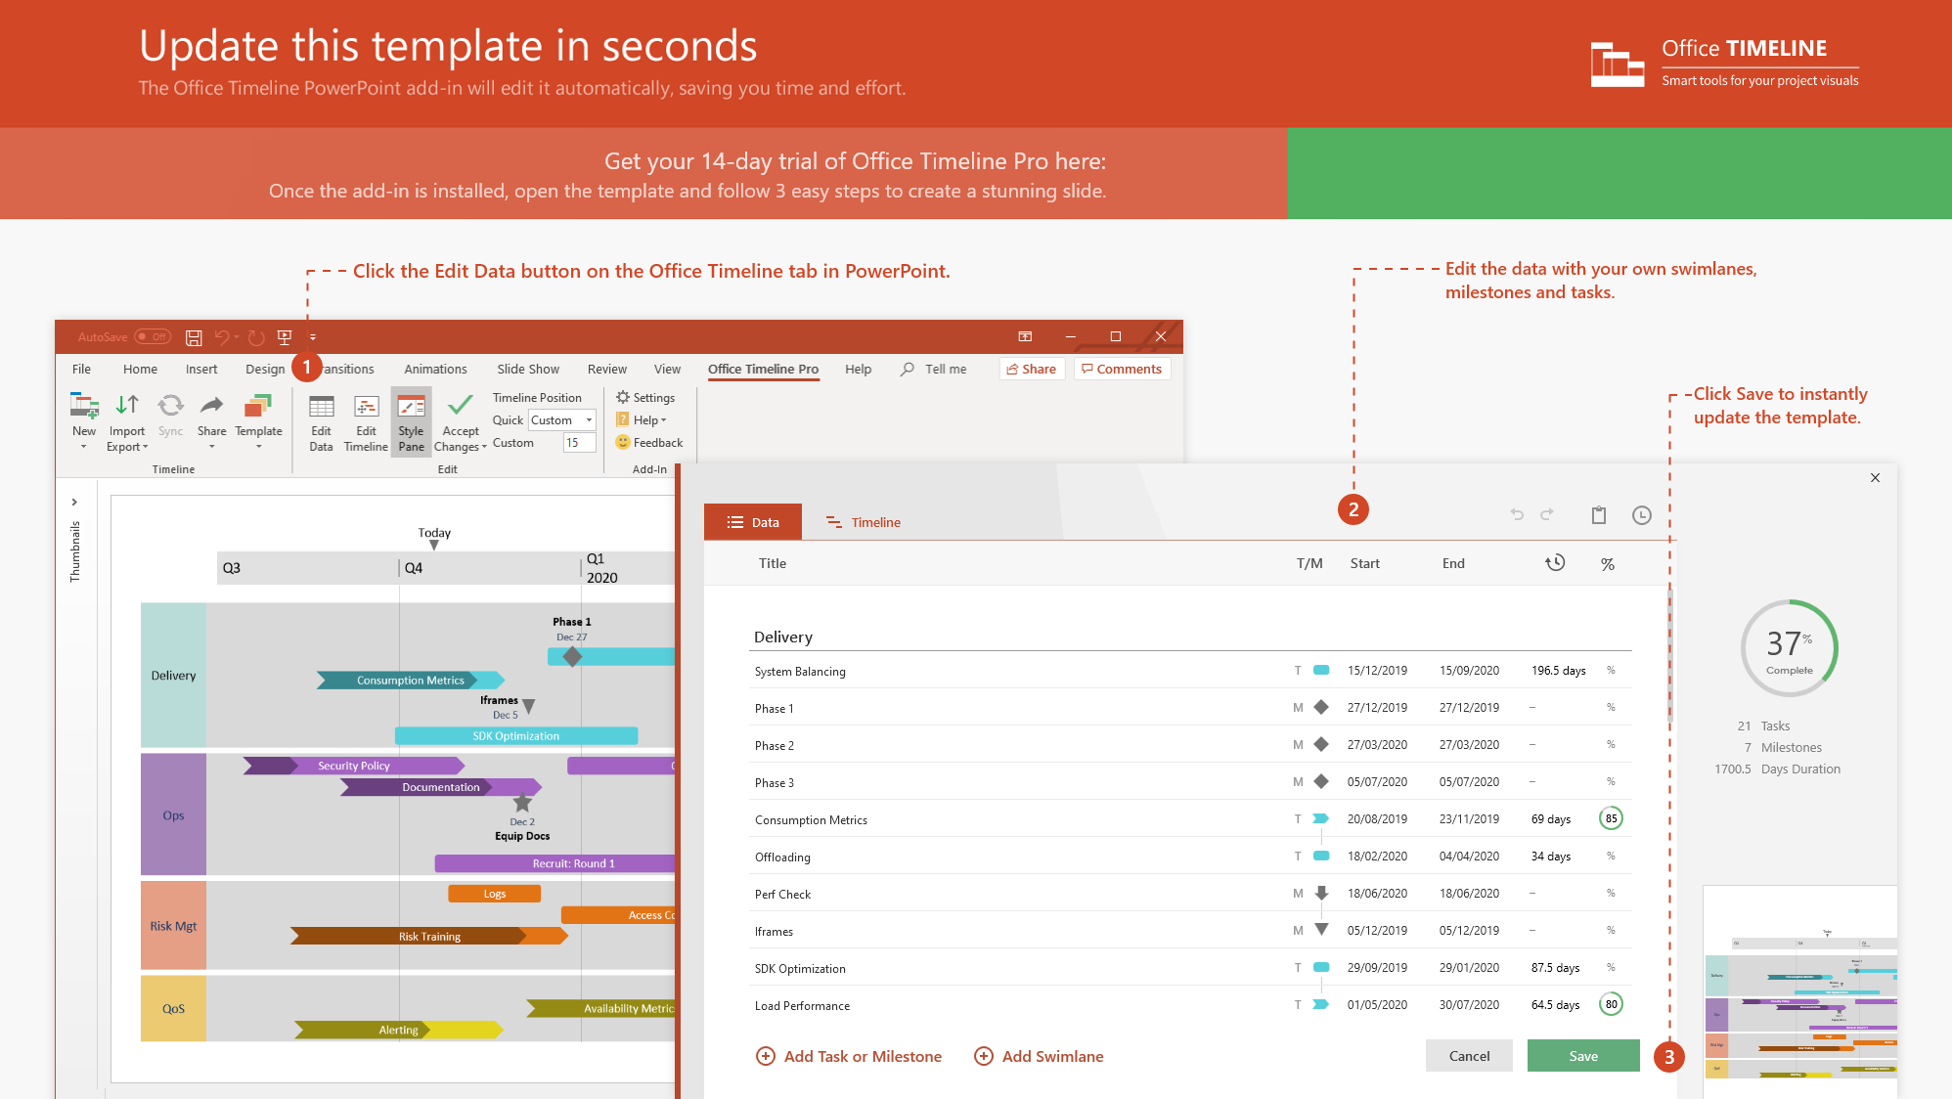
https://www.officetimeline.com/14-days-trial

Slide 2
Security guard reports fumes
9:15 am
Captain orders aeration
12:41 pm
SS Huyendo in harbor
Toxic warnings posted
Doctor boards
8:20 am
1:15 pm
2:05 pm
Inspectors board
Pesticide unit boards
First Officer leaves vessel
1:30 pm
9:30 am
4:57 pm
Pesticides ordered
Pesticide unit departs
Checked into hospital
3:49 pm
2:45 pm
5:51 pm
2021
Saturday
Sunday
Monday
2021
0 days
Today
Treatment of cargo holds 2,3, and 5.
Jan 24, 10:00 am - 4:00 pm
1 day
First Officer on board with security unit
Jan 23, 8:20 pm - Jan 25, 4:57 pm

