Slide 1
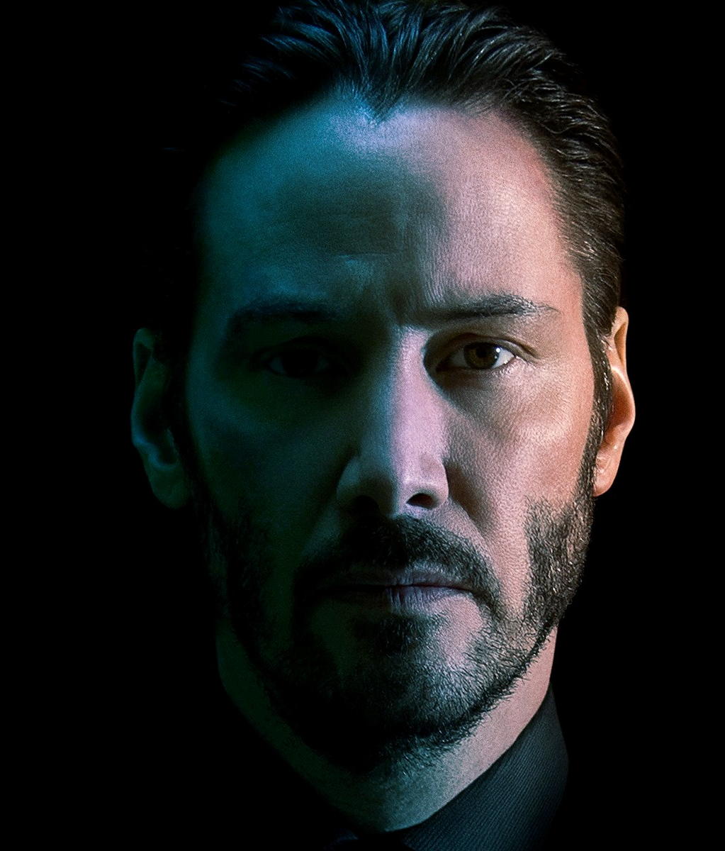

Plays Hamlet for Manitoba Theatre Centre
1st directorial movie, Man of Tai Chi, premiers
1995
2013
Bill & Ted's Excellent Adventure
The Matrix
Ode to Happiness, 1st book published
1989
1999
2011
His screen acting debut
Receives star on the Hollywood Walk of Fame
1984
2005
Drops out of high school
Point Break
The Matrix Revolutions
His 54th birthday
1981
1991
2003
Sep 2, 2018
1964
1964
1969
1974
1979
1984
1989
1994
1999
2004
2009
2014
2018
1973
1984
1997
2008
2014
Today
Appears in a theatre production
Moves to Los Angeles
The Devil's Advocate
Street Kings
John Wick
Sep 2, 1964
1986
2005
Keanu Charles Reeves is born
1st studio movie appearance in Youngblood
Constantine
1991
2011
Becomes bass player for grunge band Dogstar
Co-founds Arch Motorcycle Company
Life events
Career-related performances
1994
2003
Speed
The Matrix Reloaded

