Slide 1

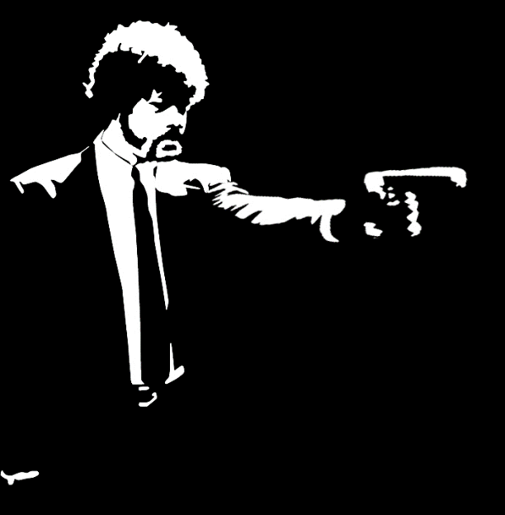
First TV role (Emergency!)
1972
Welcome Back, Kotter
Look Who's Talking
1975
1989
Gets his pilot's license
Pulp Fiction
Son, Jett, dies at age 16
1976
1994
2009
John Travolta is born
Grease
Face/Off
The Punisher
Receives Primetime Emmy Award
Feb 18, 1954
1978
1997
2004
2016
1954
1954
1960
1966
1972
1978
1984
1990
1996
2002
2008
2014
2019
1980
2007
Today
1998
Feb 18, 2018
Urban Cowboy
A Civil Action
Hairspray
64th birthday
1977
1995
2016
Saturday Night Fever
Get Shorty
American Crime Story
1991
2010
Marries Kelly Preston
Aids Haiti after catastrophic earthquake
1975
Joins the Church of Scientology
1971
Drops out of school

