Slide 1
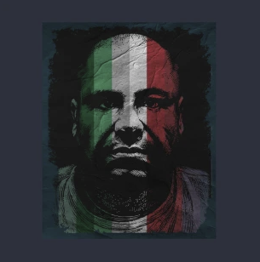
Becomes Mexico's top drug kingpin after his rival's arrest
2003
Conflict with Beltrán Leyva Carter
2008
His 2nd arrest
2014
Pioneers use of tunnels for drug trafficking
2nd prison escape
1988
2015
Joaquín "El Chapo" Guzmán is born
Conflict with the Tijuana Cartel
Captured by Mexican authorities
1957
1989
2016
Starts working for local drug lord El Güero
Sentenced to 20 years
Sentenced to life in prison + 30yrs
1970
1995
2019
1957
1957
1964
1971
1978
1985
1992
1999
2006
2013
2019
1980
2001
2017
Today
Starts working for major drug lord F. Gallardo
Makes 1st escape, aided by bribed prison staff
Extradited to the U.S.
1993
2015
His 1st arrest
Wide-range manhunt organized
1988
2013
Takes over the faction Sinaloa after Gallardo's arrest
Named Public Enemy # 1 by the Chicago Crime Commission
2004
Breaks non-aggression pact between major cartels

