Slide 1
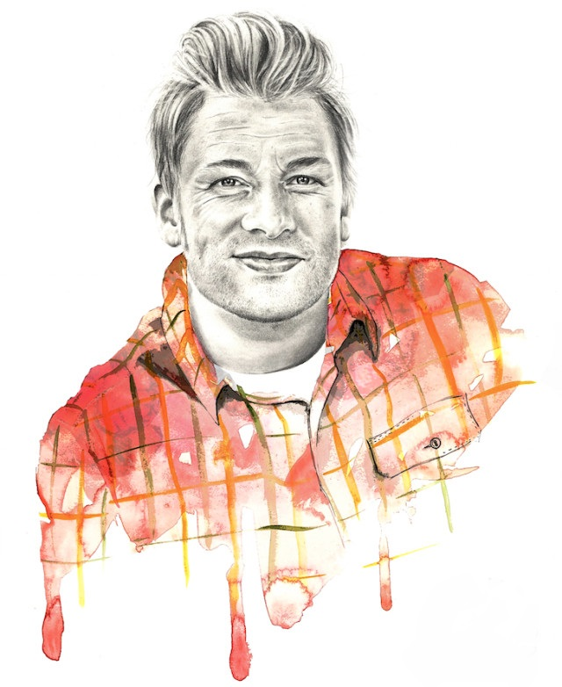
Initiates Feed Me Better campaign
2005
Starts working as a pastry chef
Launches his high-end restaurant
His 43rd birthday
1996
2008
May 27, 2018
1st cookbook, bestseller in the UK
Jamie Oliver's Food Revolution airs
1999
2010
Born in Clavering, Essex
Starts the TV show Jamie's Kitchen
National nutrition campaign with Sobeys
May 27, 1975
2002
2013
1975
1975
1979
1983
1987
1991
1995
1999
2003
2007
2011
2015
2018
2003
2015
Today
MBE for services to the hospitality industry
2nd Greatest British Entrepreneur (Top 100)
2000
2011
Marries Juliette Norton
Sets up Barbecoa restaurant
1999
2009
Debuts his BBC show - The Naked Chef
Receives the 2010 TED Prize
1991
2005
Enrolls at Westminster Kingsway College
Voted as the Most Inspiring Political Figure of 2005

