Slide 1
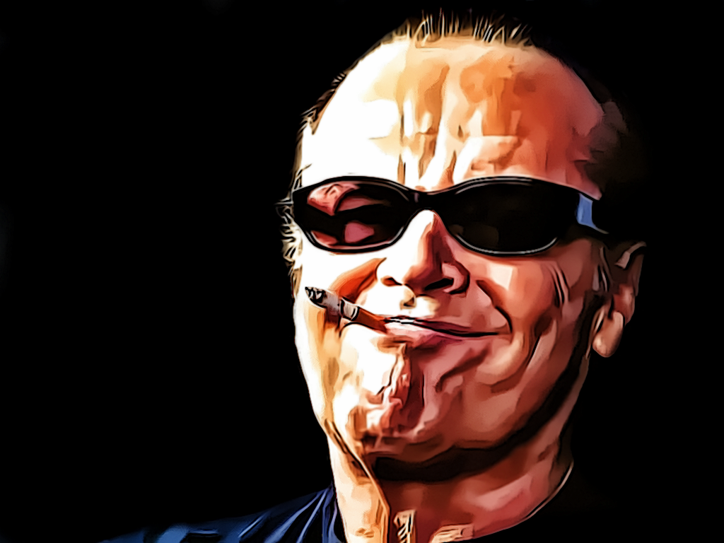
Graduates from high school
Five Easy Pieces
Batman
81st birthday
1954
1970
1989
22 Apr '18
Chinatown
As Good as It Gets
1974
1997
John Joseph Nicholson is born
Joins the Air National Guard
The Shining
The Bucket List
22 Apr '37
1957
1980
2007
1937
1937
1944
1951
1958
1965
1972
1979
1986
1993
2000
2007
2014
2020
1963
1975
2011
Today
First child
One Flew Over the Cuckoo's Nest
Honorary D.F.A degree from Brown
1973
1992
2006
The Last Detail
A Few Good Men
The Departed
1969
1983
Easy Rider
Terms of Endearment

