Slide 1
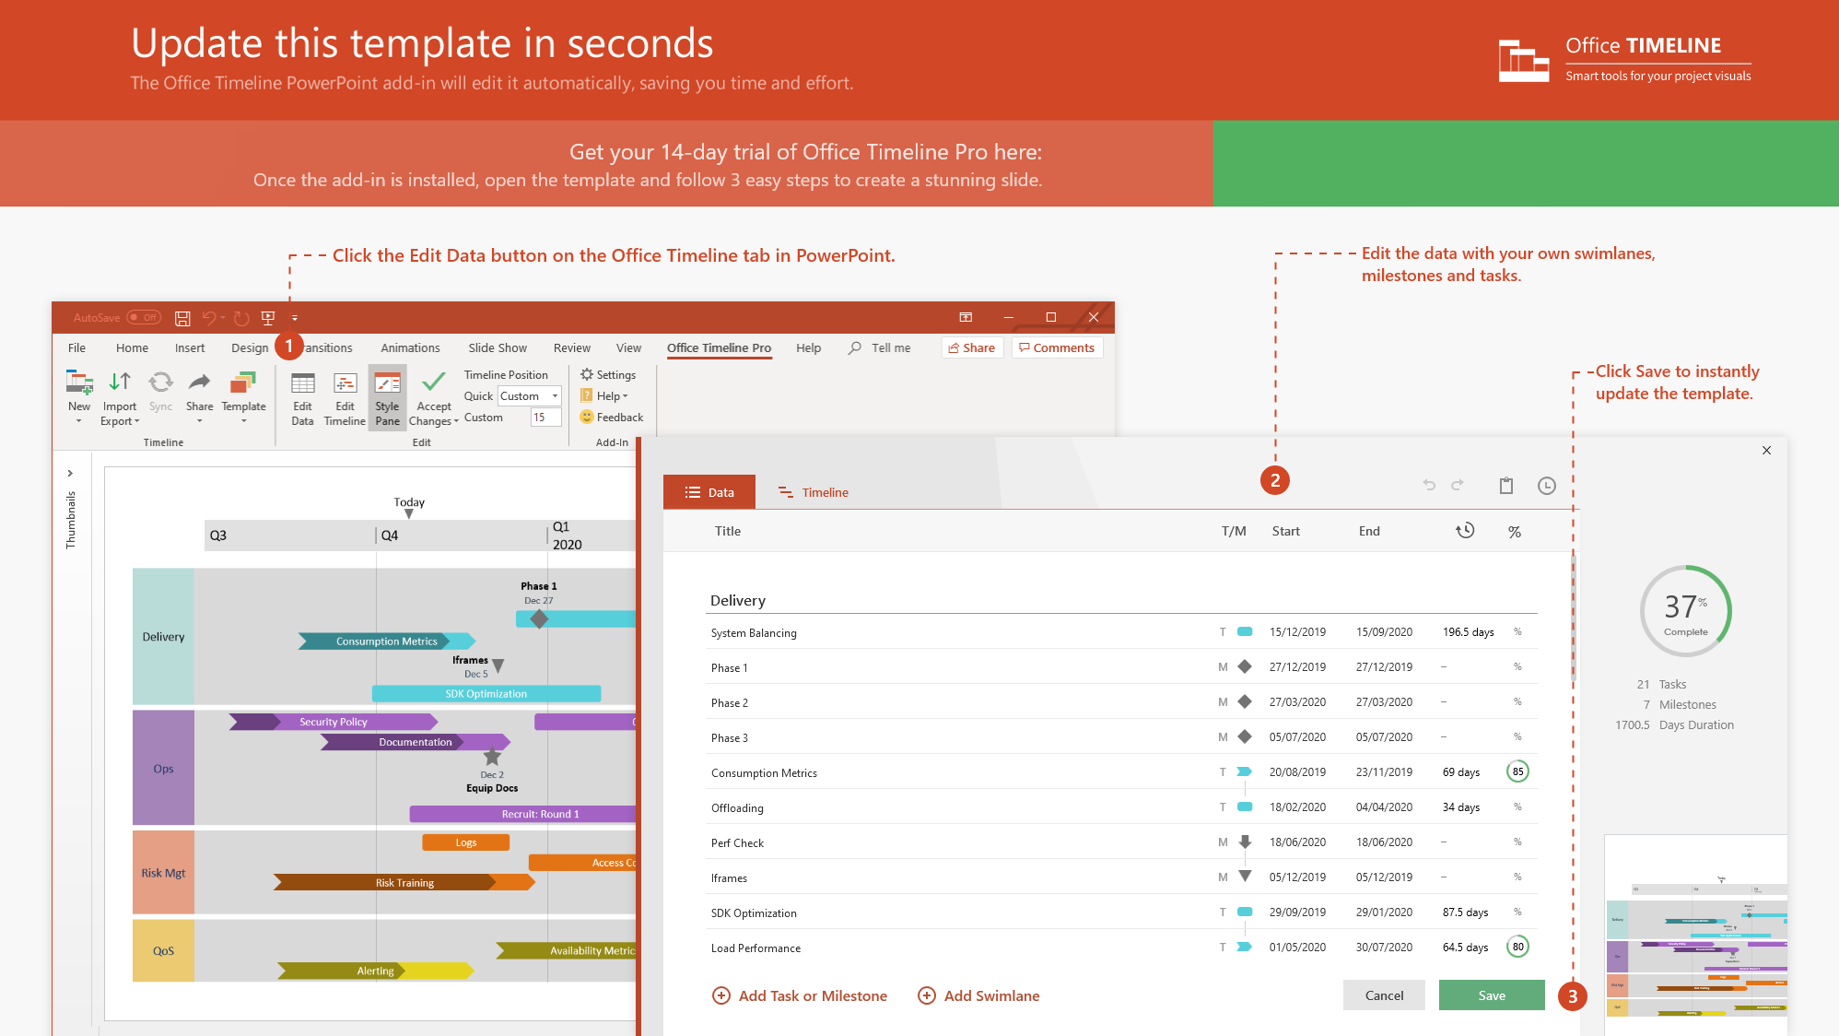
https://www.officetimeline.com/14-days-trial

Slide 2



International Women’s Day Timeline
1st International Women's Day celebrated by the UN
1975
1st time IWD has a theme:
“Celebrating the past, Planning for the Future”
15,000 women march in New York City
1996
1908
Women’s “Bread and peace” strike in Russia
IWD Centenary
1917
2011
1906
1919
1932
1945
1958
1971
1984
1997
2010
1913
2001
International Women’s Day set on March 8
Launch of InternationalWomensDay.com
1911
2011
1st International Women’s Day & “Bread and Roses” campaign
March 2011 “Women’s History Month”
1909
1st National Women’s Day

