Slide 1

Motor Sports Land Co. is established
1961
2 million motorcycles produced
1973
Announces world's first ABS for motorcycles
Announces world's first SH-AWD system
1987
2004
Honda is incorporated
Wins its first Formula One
Launches the Accord
30 million automobiles produced worldwide
Begins HondaJet production
Sep 24, 1948
1965
1976
1995
2012
Starts exporting the Juno to the US
Driving Safety Promotion Center
10 million power products produced
Unveils the ASIMO humanoid robot
Begins sales of Walking Assist Device
1954
1970
1985
2000
2015
1948
1948
1955
1962
1969
1976
1983
1990
1997
2004
2011
2017
1958
1974
1986
2003
Today
Sep 24, 2017
Introduces the Super Cub
Launches the Gold Wing GL1000
Launches Acura
Launches the Pantheon
69th anniversary
1950
1962
1981
1997
2012
Tokyo plant is established
Introduces its first automobiles
Announces the first car navigation system
Starts leasing EV Plus
100 mil automobiles produced worldwide
1972
1993
2008
Launches the Civic
Wins the World Solar Challenge
Bodyweight Support Assist announced
1968
10 million motorcycles produced

Slide 2
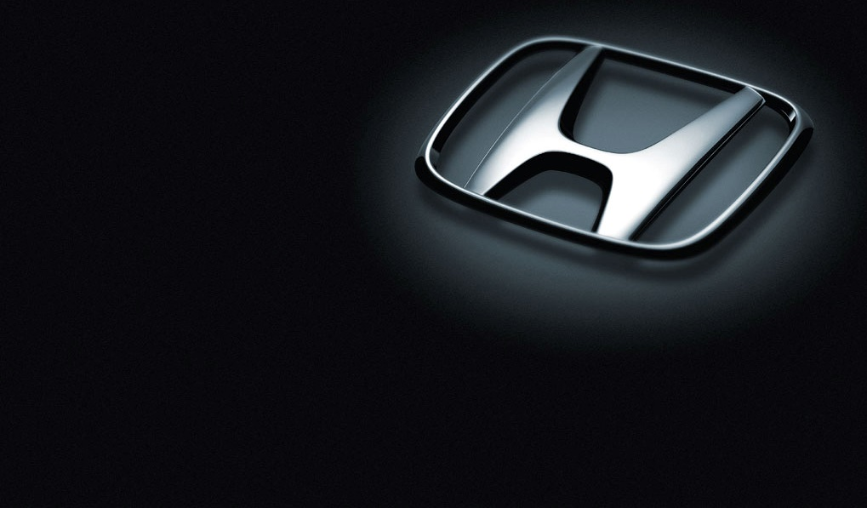
Motor Sports Land Co. is established
1961
2 million motorcycles produced
1973
Announces world's first ABS for motorcycles
Announces world's first SH-AWD system
1987
2004
Honda is incorporated
Wins its first Formula One
Launches the Accord
30 million automobiles produced worldwide
Begins HondaJet production
Sep 24, 1948
1965
1976
1995
2012
Starts exporting the Juno to the US
Driving Safety Promotion Center
10 million power products produced
Unveils the ASIMO humanoid robot
Begins sales of Walking Assist Device
1954
1970
1985
2000
2015
1948
1948
1955
1962
1969
1976
1983
1990
1997
2004
2011
2017
1958
1974
1986
2003
Today
Sep 24, 2017
Introduces the Super Cub
Launches the Gold Wing GL1000
Launches Acura
Launches the Pantheon
69th anniversary
1950
1962
1981
1997
2012
Tokyo plant is established
Introduces its first automobiles
Announces the first car navigation system
Starts leasing EV Plus
100 mil automobiles produced worldwide
1972
1993
2008
Launches the Civic
Wins the World Solar Challenge
Bodyweight Support Assist announced
1968
10 million motorcycles produced

