Slide 1
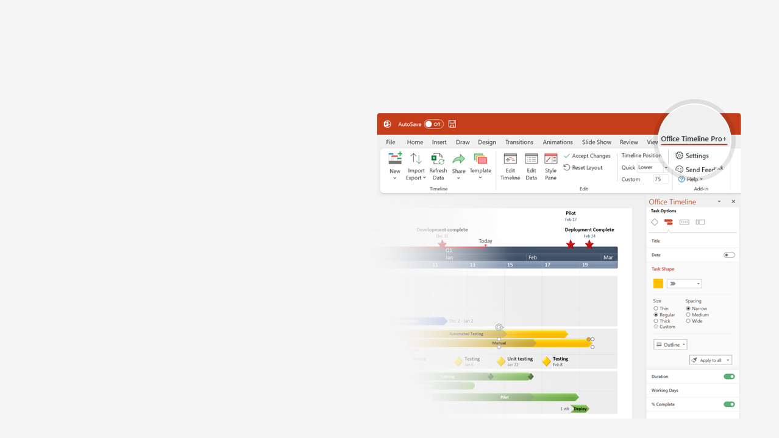

How to update this template in seconds
The Office Timeline add-in for PowerPoint will help you edit it with just a few clicks.
Get your free 14-day trial of Office Timeline here:
https://www.officetimeline.com/14-days-trial
Re-open this template, and create your impressive
PowerPoint visual in 3 easy steps:
1
Click the Edit Data button on the Office Timeline tab.
2
Use the Data and Timeline views to edit swimlanes, milestones and tasks.
3
Click Save to instantly update the template.

Slide 2


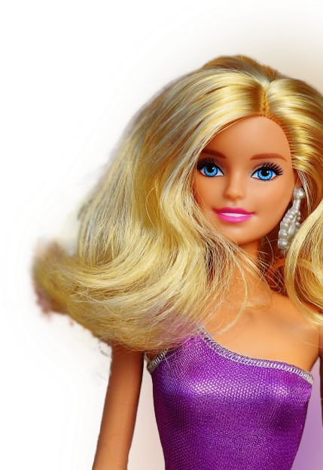
Barbie
HISTORY OF TIMELINE
Barbie's Debut
#MoreRoleModels
Mar 9, 1959
2018
Ken Carson's Premiere
Barbie runs
for president
First NY
Runway Show
First Diverse Dolls
Barbie Movie
1961
1980
1992
2009
Jul 21, 2023
1959
1965
1971
1977
1983
1989
1995
2001
2007
2013
2019
1965
Astronaut Barbie
1960s
1967
First Celebrity Barbie
1968
Christie is introduced
1969
New Living Barbie Doll
1971
Malibu Barbie
1970s
1971
First Camper
1972
Busy Barbie
1984
First Fashion Partnership
1980s
1985
CEO Barbie
1985
"We Girls Can Do Anything" Campaign
1986
Andy Warhol Painting
2012
Ella, the Chemo Barbie
2000s
2014
@barbiestyle
2015
Barbie Sheroes
2016
New Body Types

