Slide 1
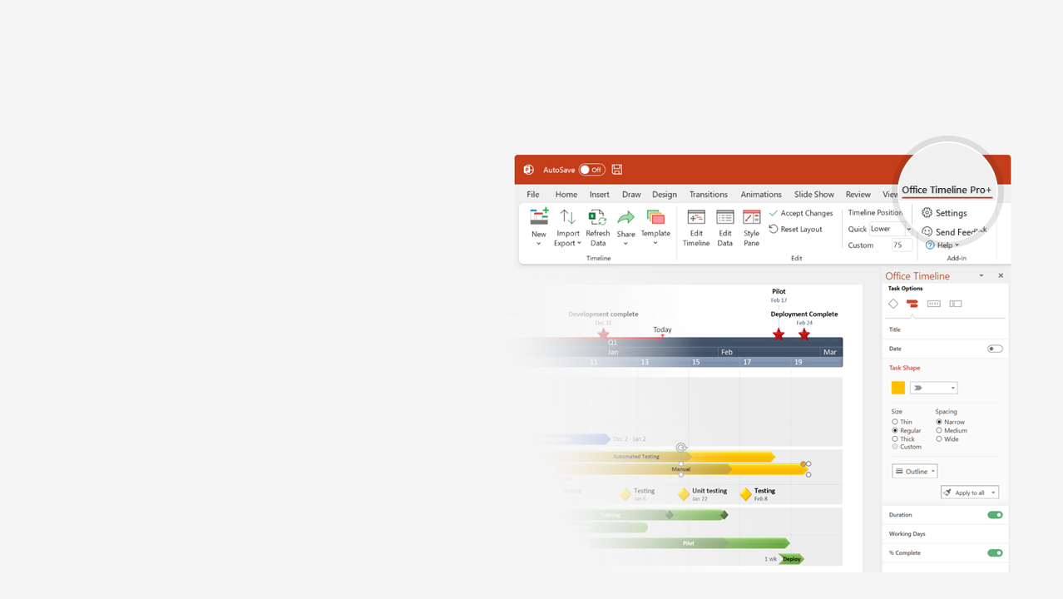

How to update this template in seconds
The Office Timeline add-in for PowerPoint will help you edit it with just a few clicks.
Get your free 14-day trial of Office Timeline here:
https://www.officetimeline.com/14-days-trial
Re-open this template, and create your impressive
PowerPoint visual in 3 easy steps:
1
Click the Edit Data button on the Office Timeline tab.
2
Use the Data and Timeline views to edit swimlanes, milestones and tasks.
3
Click Save to instantly update the template.

Slide 2




1997
Today
2023
TPUs
Jun 2016
Domain
google.com
is registered
Launches
Google Image
Search
Initial
Public Offering
Buys DoubleClick
Introduces
Knowledge Graph
Announces
restructuring
as Alphabet Inc.
Buys
HTC
Ubisoft and
Take-Two
bring games
to Stadia
Apr 2007
Nexus One
BARD
Aug 2004
Street View
Jan 2010
May 2012
Sep 2017
Mar 2023
Sep 1997
Jul 2001
Yahoo
drops
partnership
Research
partnership
with NASA
May 2007
Launches
Google+
Buys Waze
Aug 2015
Mar 2021
First
Google Doodle
Google Chrome
Google sells Mobility,
buys Nest
Launches
Google Pixel
Launches
Google Stadia
25 years
of Google
Aug 1998
Feb 2004
Sep 2005
Sep 2008
Jun 2011
Jan 2014
Oct 2016
Nov 2019
Sep 27, 2023
1997
2000
2003
2006
2009
2012
2015
2018
2021
Feb 2003
Feb 2005
Apr 2012
Sep 2015
Apr 2022
Sep 4, 1998
Acquires
Pyra Labs
(Blogger)
Launches
Google Maps
Google Drive
New
logo
Sep 2017
Adds
Privacy Guide
to Chrome
Google
officially founded
Nov 2006
Sep 2008
Announces
restructuring
as Google LLC
Buys
YouTube
Releases
Android OS
Jan 2013
Oct 2020
May 2011
Partnership
with
Kia Motors
and
Hyundai
US DOJ
files antitrust
complain
Record:
1 billion
unique
site visitors
Apr 2016
May 2022
Oct 2000
Apr 2006
EU files
antitrust complaint
against Google
Nov 2018
Acquires
MicroLED and
Raxium
Google
AdWords
Launches Google Translate
BERT

