Slide 1
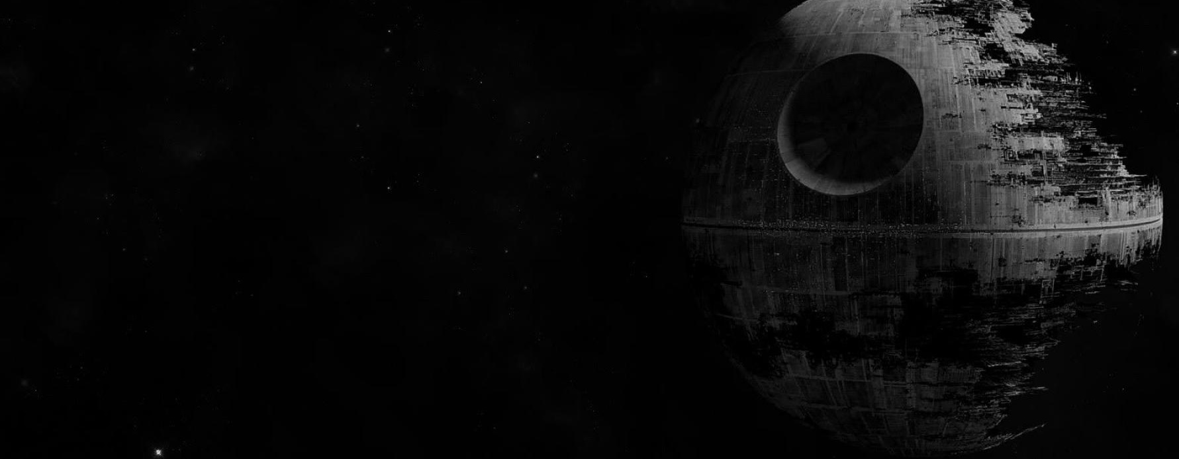
American Graffiti
GL Educational Foundation
1973
1991
Star Wars: Episode V
1980
Adopts Amanda
1981
Adopts Katie
Signs the Giving Pledge
1988
2010
Graduates from USC
Star Wars: Episode VI
Star Wars: Episode I
Marries Mellody Hobson
George Lucas is born in Modesto, CA
1967
1983
1999
2013
THX 1138
Star Wars: Episode III
73rd Birthday
May 14, 1944
1971
2005
May 14, 2017
1944
1944
1951
1958
1965
1972
1979
1986
1993
2000
2007
2014
2020
1983
2002
2013
Today
Divorce
Star Wars: Episode II
3rd daughter born (Everest)
1971
1993
2012
Founds Lucasfilm
Adopts Jett
Sells Lucasfilm to Disney
1962
1981
2008
Suffers near-fatal crash
Raiders of the Lost Ark
Star Wars: The Clone Wars
1984
1969
Indiana Jones and the Temple of Doom
Life
Marries Marcia Lou Griffin
1977
1989
Career
Star Wars
Indiana Jones and the Last Crusade
Movies

