Slide 1
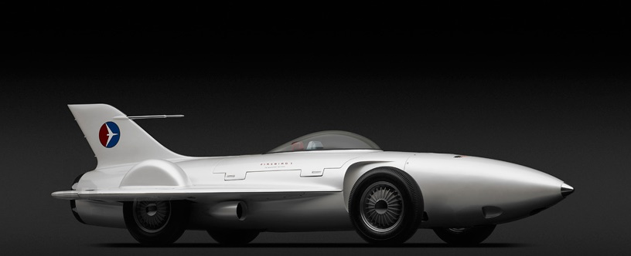
Shifts most truck production to war effort
1917
1 millionth Buick is build
Launch of the Saturn
1923
1990
Designs the world’s first concept car
Last model year for Oldsmobile
1938
2004
Introduces the first fully automatic transmission
Becomes the largest private employer in the US
Files for Chapter 11 bankruptcy
1940
1979
2009
GM founded
Acquires Electro-Motive
First demo of an automatically guided vehicle
56-day strike at GM's Flint stamping operations
109th anniversary
Sep 16, 1908
1930
1958
1997
Sep 16, 2017
1908
1908
1918
1928
1938
1948
1958
1968
1978
1988
1998
2008
2017
1918
1940
1967
1994
2013
Today
Acquires Chevrolet
The Nazi government seizes control of Adam Opel AG
100 millionth Cadillac is built
Introduces DirecTV
GM vehicles win 3 prestigious awards
1929
2009
Acquires Adam Opel AG
Toyota surpasses GM as the world's largest automaker
1948
1999
Introduces the industry's first V8 engines
Acquires rights to the Hummer brand
1909
GM acquires Cadillac

