Slide 1
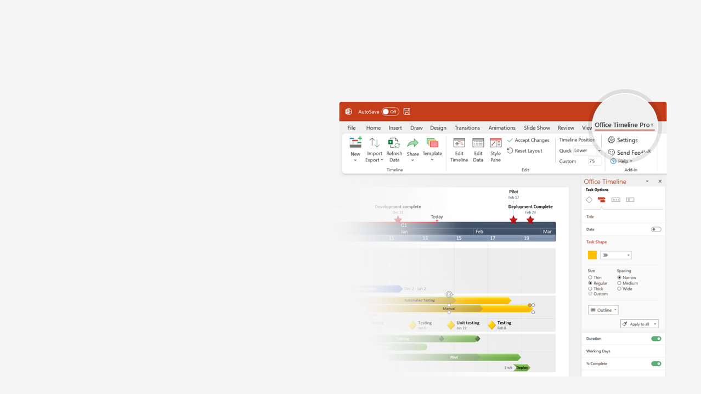

How to update this template in seconds
The Office Timeline add-in for PowerPoint will help you edit it with just a few clicks.
Get your free 14-day trial of Office Timeline here:
https://www.officetimeline.com/office-timeline/14-days-trial
Re-open this template, and create your impressive
PowerPoint visual in 3 easy steps:
1
Click the Edit Data button on the Office Timeline tab.
2
Use the Data and Timeline views to edit swimlanes, milestones and tasks.
3
Click Save to instantly update the template.

Slide 2





2004
2006
2008
2010
2012
2014
2016
2018
2020
2022
“TheFacebook” launches
Facebook Beacon launches. Privacy concerns.
Stickers are launched
Facebook reactions are launched
Launches Dark Mode for mobile
Feb 4, 2004
Nov 2007
May 2013
Feb 2016
Jun 2020
Acquires Facebook.com domain
The "Like" button is introduced
Facebook Timeline is introduced
Look Back videos are introduced
Announces Facebook Spaces
Shutdown of face recognition
Product
Aug 2005
Feb 2009
Sep 2011
Feb 2014
Apr 2017
Nov 2021
Introduces tagging
Beacon is shut down
Announces support for GIFs
Daily active users drop for the first time in FB history
Dec 2005
Sep 2009
May 2015
Feb 2022
News Feed is launched
Featured Posts start showing in the News Feed
Secret soccer game in Messenger
Eases rules to allow violent speech against 'Russian invaders'
Sep 2006
Jan 2012
Jun 2016
Mar 2022
LLC is formed
Facebook goes mobile
Partners with Skype to add video chat
Acquires WhatsApp
Acquires social media app tbh
Purchases GIPHY
Apr 2004
Jan 2007
Jun 2011
Feb 2014
Oct 2017
May 2020
ConnectU sues Facebook
Settles dispute with ConnectU
Acquires Instagram
Creates custom Tor link
Cambridge Analytica data scandal
Data breach exposes 530m users
Company
Sep 2004
Jun 2008
Apr 2012
Oct 2014
Mar 2018
May 2021
First official investment: $500,000
International headquarters in Dublin
1 billion active users
Facebook Inc. renamed as
Meta Platforms Inc.
Jun 2004
Oct 2008
Oct 2012
Oct 2021
Facebook Inc. goes public
May 2012

