Slide 1
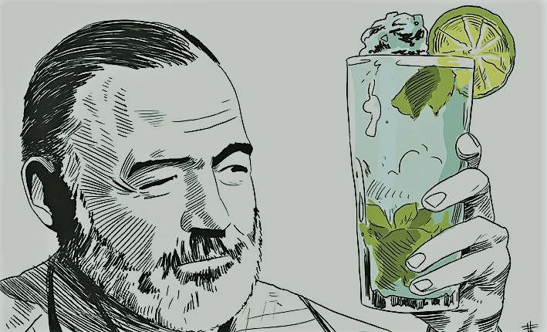
Marries Hadley Richardson & moves to Paris
1921
1st book is published (short stories & poems)
1923
The Sun Also Rises
Marries Mary Welsh
Commits suicide
1926
1946
Jul 2, 1961
Becomes reporter for The Kansas City Star
A Farewell to Arms
Almost dies after 2 successive plane crashes
1917
1929
1954
Ernest Hemingway is born
Enlists as Red Cross ambulance driver in WWI
Goes on safari to East Africa
The Old Man and the Sea
Jul 21, 1899
1918
1933
1951
1899
1899
1906
1913
1920
1927
1934
1941
1948
1955
1961
Today
1927
1940
1954
Marries Pauline Pffeifer
For Whom the Bell Tolls
Receives the Nobel Prize in Literature
1925
1952
In Our Time
Wins the Pulitzer Prize
1924
1947
Befriends F. Scott Fitzgerald
Awarded Bronze Star for bravery during WWII
1944
Takes part in the Normandy Landings
1937
Moves to Spain to cover the Civil War
Life events
Published works
1932
Death in the Afternoon

