Slide 1
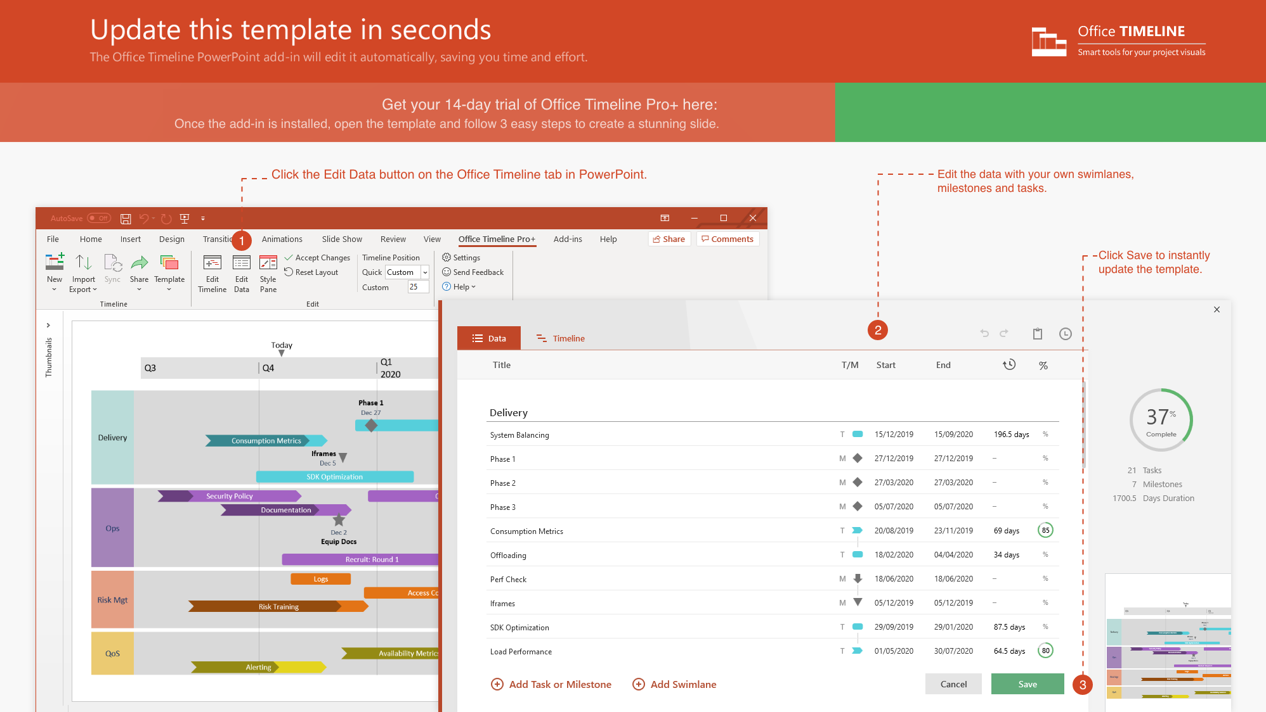
https://www.officetimeline.com/14-days-trial

Slide 2
10 mons
Clinical Trial Roadmap
COPA Human Trials in USA
Patients Recruited
Jan 15, 2020
Patients Enrolled
Patients Recruited
Mar 1, 2020
Nov 15, 2020
Study Kick-off
Patients Enrolled
Study Kick-off
Apr 1, 2020
Dec 15, 2020
Mar 15, 2021
Phase I Trial
Phase II Trial
11 mons
Jan 2020 - Oct 2020
Nov 2020 - Sep 2021
Phase III Trial
6 mons
May 31 - Nov 30
2020
Jan
Mar
May
Jul
Sep
Nov
2021
Mar
May
Jul
Sep
Nov
2021
Oct 15, 2020
Today
May 31, 2021
Sep 30, 2021
Nov 30, 2021
Report
Apply for Drug Approval
Report
Estimated Drug Approval Date

