Slide 1
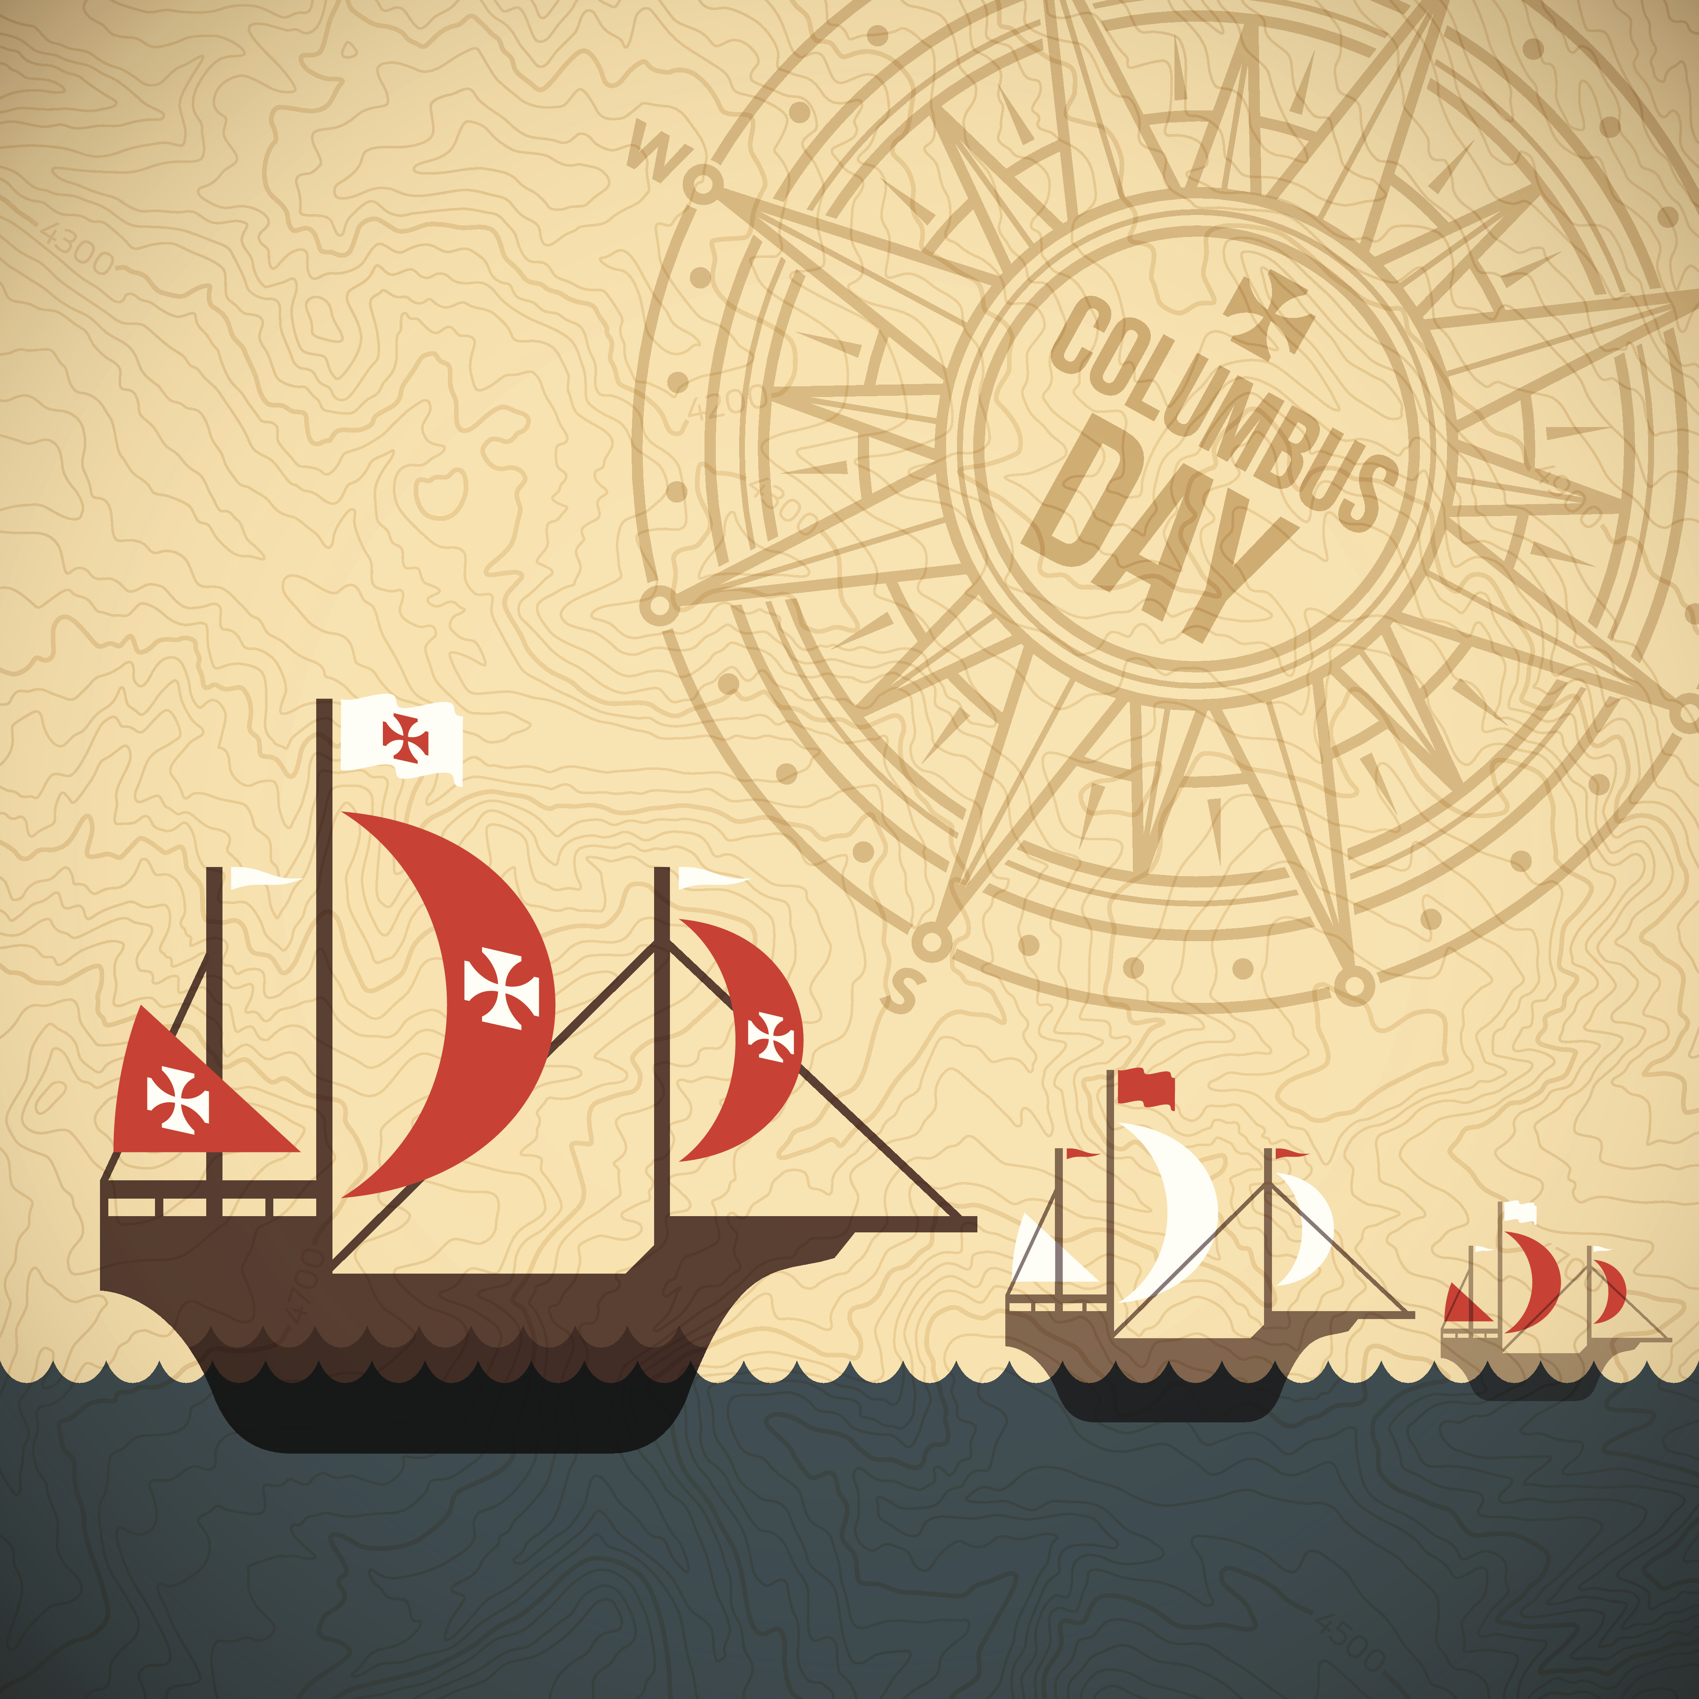

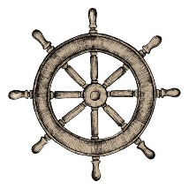



Made With
Obtains funding from the king and queen of Spain
Earns financial
independence in Khios
1491
Passes away from Reiter's Syndrome in Spain, age 55
1474
England and Portugal refuse
to sponsor his discovery voyage
1506
Christopher Columbus
is born in Genoa
1484
Journeys to the America for the 2nd time, leaves his brother behind to establish a colony
1451
First sea voyage
1465
Marries Felipa Perestrella e Moniz and lives in Portugal
1493
Sails to the Americas for the 4th and last time, spends a year in Jamaica
1479
1502
1451
1456
1461
1466
1471
1476
1481
1486
1491
1496
1501
1506
1485
1498
Moves to Spain
Takes a 3rd trip to America, fares no better than before
1480
1st big voyages on the route from Portugal to Iceland
1492
Sets sail to find a new route from Europe to Asia, ends up discovering the American Continent

