Slide 1

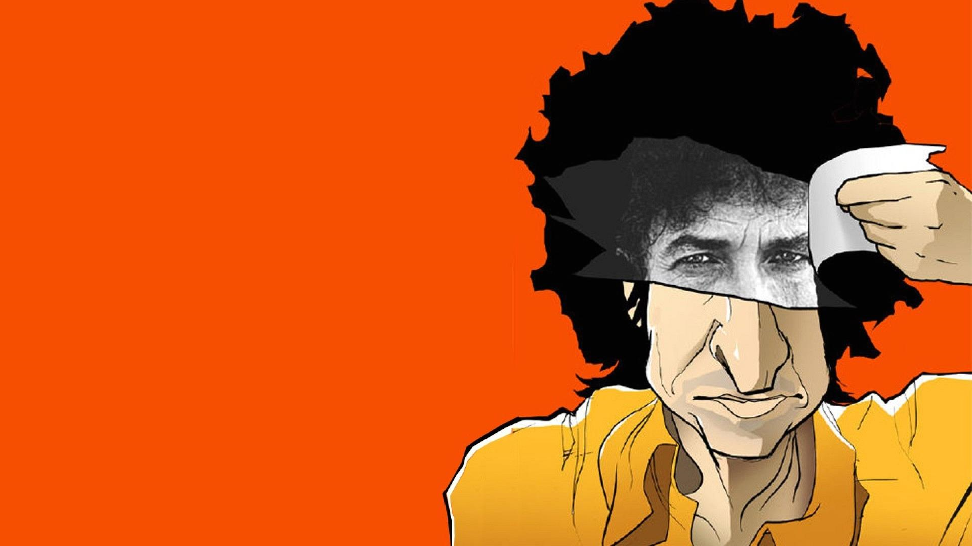

Self Portrait
8 Jun, 1970
Blood on the Tracks
20 Jan, 1975
Bob Dylan (debut album)
Pat Garrett & Billy the Kid
19 Mar, 1962
13 Jul, 1973
Under the Red Sky
Modern Times
Shadows in the Night
The Times They Are a-Changin'
10 Sep, 1990
29 Aug, 2006
3 Feb, 2015
13 Jan, 1964
John Wesley Harding
Street Legal
Infidels
Time Out of Mind
Tempest
Triplicate
27 Dec, 1967
15 Jun, 1978
27 Oct, 1983
30 Sep, 1997
10 Sep, 2010
31 Mar, 2017
1962
1962
1969
1976
1983
1990
1997
2004
2011
2017
Today
9 Apr, 1969
5 Jan, 1976
23 Jun, 1980
26 Oct, 1993
11 Sep, 2001
20 May, 2016
Nashville Skyline
Desire
Saved
World Gone Wrong
Love and Theft
Fallen Angels
30 Aug, 1965
17 Jan, 1974
14 Jul, 1986
28 Apr, 2009
Highway 61 Revisited
Planet Waves
Knocked Out Loaded
Together Through Life
27 May, 1963
The Freewheelin' Bob Dylan
“All I can do is be me, whoever that is.”
Release dates of the artist’s major albums

