Slide 1
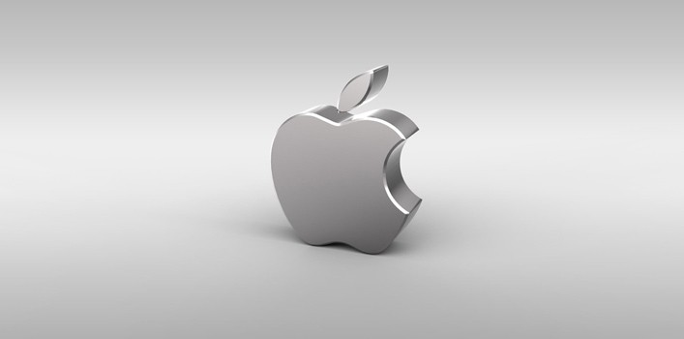


Launches the iPhone & Apple TV under new name Apple Inc.
2007
Apple Computer Company is founded
Apr 1, 1976
S. Jobs leaves the company
1985
The Macintosh Portable
First retail stores
Jobs resigns (health problems)
1989
2001
2011
Apple II
Apple III
The Macintosh
The PowerBook
The iMac
The iPad
Apple Watch
42nd anniversary
1977
1980
1984
1991
1998
2010
2015
2018
1976
1976
1980
1984
1988
1992
1996
2000
2004
2008
2012
2016
2019
1976
1990
1997
2003
2008
2012
2017
Today
Apple I
3 new Macintosh models
Apple Online Store
iTune Store
App Store
The iPhone 5
Clips Service
1980
2001
2010
Company goes public for $22 per share
The iPod
Apple shares reach an all-time high
2010
The iPhone 4
1997
S. Jobs regains position as CEO
Company-related events
Products and services launched

