Slide 1
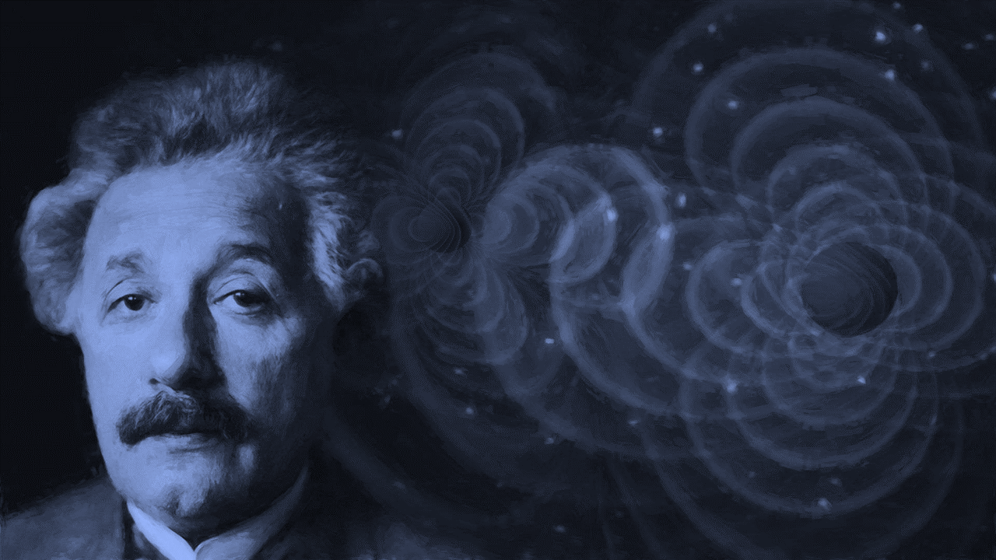


Appointed professor at German University of Prague
1911
Letter to Roosevelt on nuclear weaponry
1939
Renounces German citizenship
First paper on Unified Theory
1896
1922
Finishes first scientific paper
Born in Ulm, Germany
1901
The "Einstein-Institute" is open
Dies at Princeton Hospital
1879
1924
1955
1879
1886
1893
1900
1907
1914
1921
1928
1935
1942
1949
1922
1949
Awarded Nobel Prize for Physics
Publishes Autobiographical Notes
1903
1944
Marries Mileva Maric
Special relativity paper auctioned for $6 million
1916
1884
Publishes general theory of relativity
1952
Compass kindles his wonder and curiosity
Offered presidency of Israel
1919
Divorces Mileva Maric, marries his cousin Elsa
Made with

Slide 2
Appointed professor at German University of Prague
1911
First paper on Unified Theory
Dies at Princeton Hospital
1922
1955
Born in Ulm, Germany
1879
Publishes general theory of relativity
Letter to Roosevelt on nuclear weaponry
Compass elicits his wonder
1939
1884
1916
Finishes first scientific paper
The "Einstein-Institute" is open
Publishes Autobiographical Notes
1901
1924
1949
1879
1886
1893
1900
1907
1914
1921
1928
1935
1942
1949
1903
1922
1944
Marries Mileva Maric
Awarded Nobel Prize for Physics
Special relativity paper auctioned for $6 million
1928
Physical collapse, diagnosed with enlarged heart
1936
1914
His wife Elsa passes away
1952
1880
Separates from Mileva Maric
Offered presidency of Israel
Family relocates to Munich
1940
Earns U.S. Citizenship
1919
1896
Divorces Mileva Maric, marries his cousin Elsa
Renounces German citizenship
1917
Named Director of Kaiser Wilhelm Institute for Physics
Made with

