Slide 1
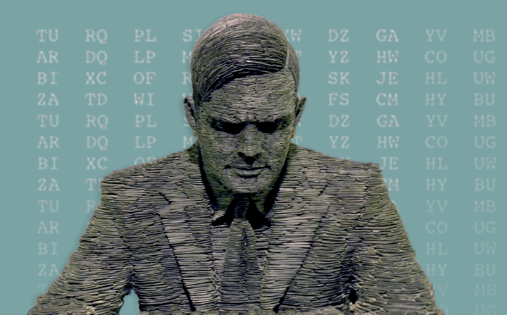
Obtains PhD from Princeton University
1938
Invents tool to break German Enigma messages
1940
Appointed as Officer of OBE for wartime services
1946
Computing Machinery and Intelligence
1950
Enrolls at Hazelhurst Preparatory School
Elected as fellow of King's College
The Chemical Basis of Morphogenesis
1922
1935
1952
Alan Turing is born
Studies Einstein's work by himself
Devises the Turingery technique
Dies of cyanide poisoning
June 23, 1912
1928
1942
June 7, 1954
1912
1912
1916
1920
1924
1928
1932
1936
1940
1944
1948
1952
1955
Today
1938
1952
Starts working for GC&CS
Convicted to chemical castration
1934
1950
Graduates from King's College
Creates the Turing test
1948
Appointed Reader at the Univ. of Manchester
1946
1st detailed design of a stored-program computer
1942
Works with US cryptanalysts on the naval Enigma
1936
1st paper on computable numbers

